Slide 1
Chapter 9
Design via Root Locus

Slide 2
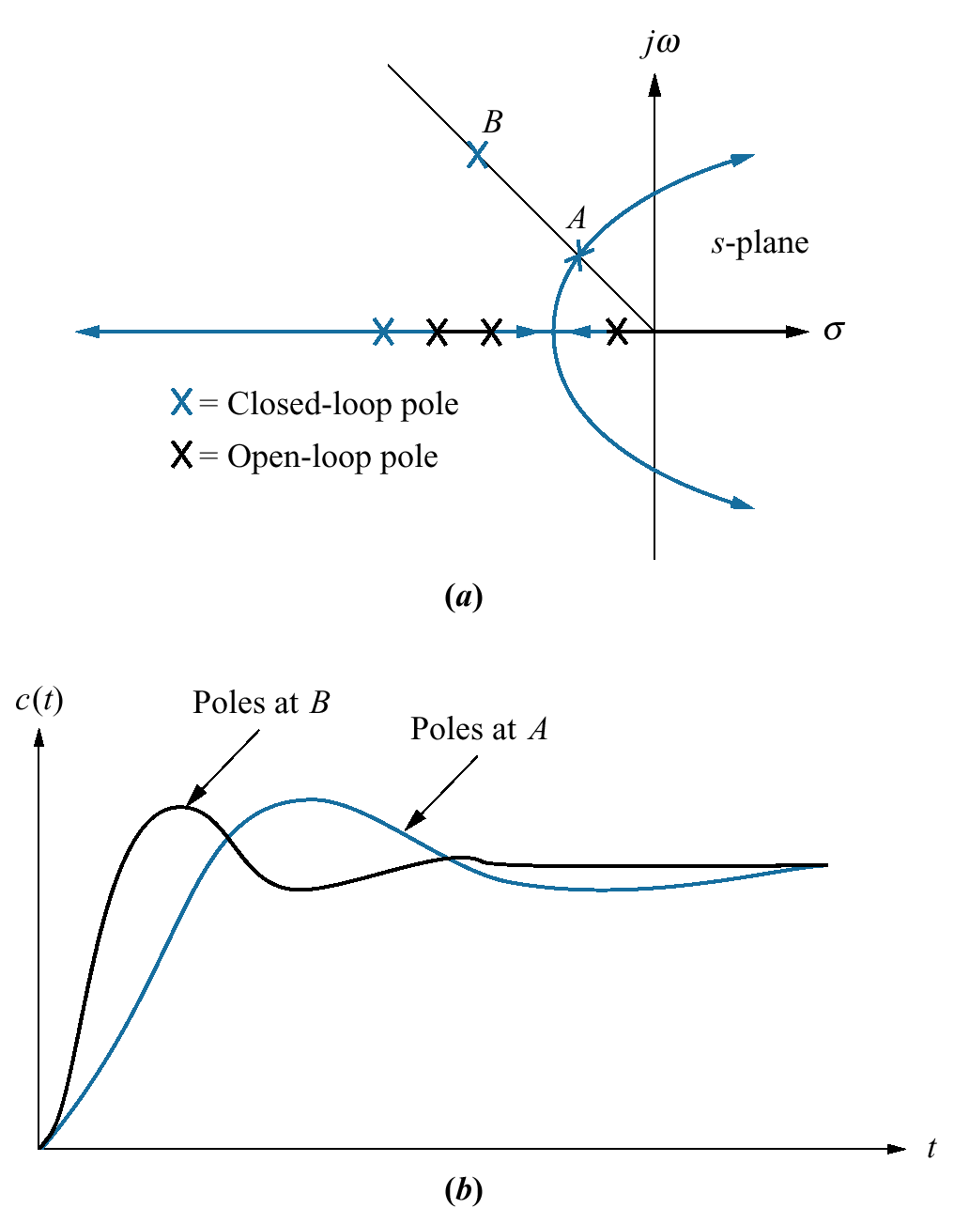
Figure 9.1
a. Sample root locus,
showing possible
design point via
gain adjustment (A)
and desired design
point that cannot be
met via simple gain
adjustment (B);
b. responses from
poles at A and B

Slide 3
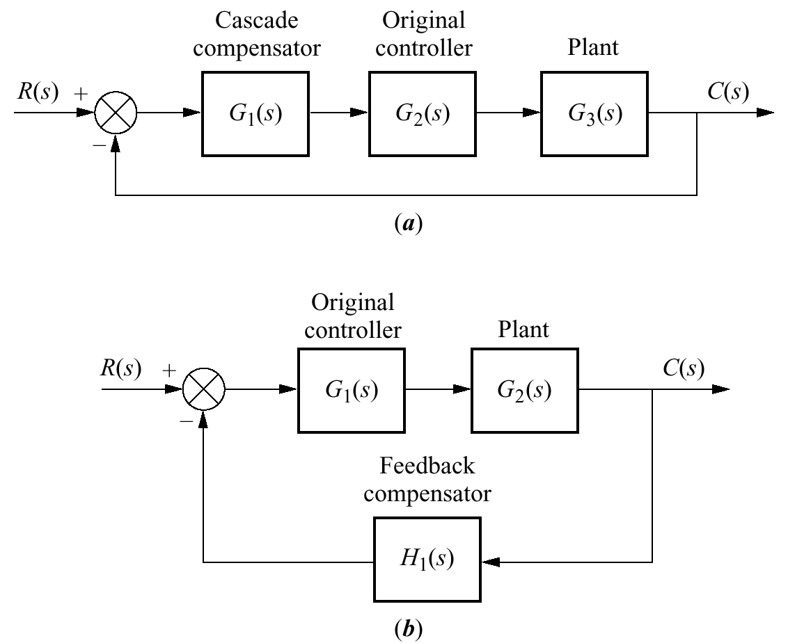
Figure 9.2
Compensation
techniques:
a. cascade;
b. feedback

Slide 4
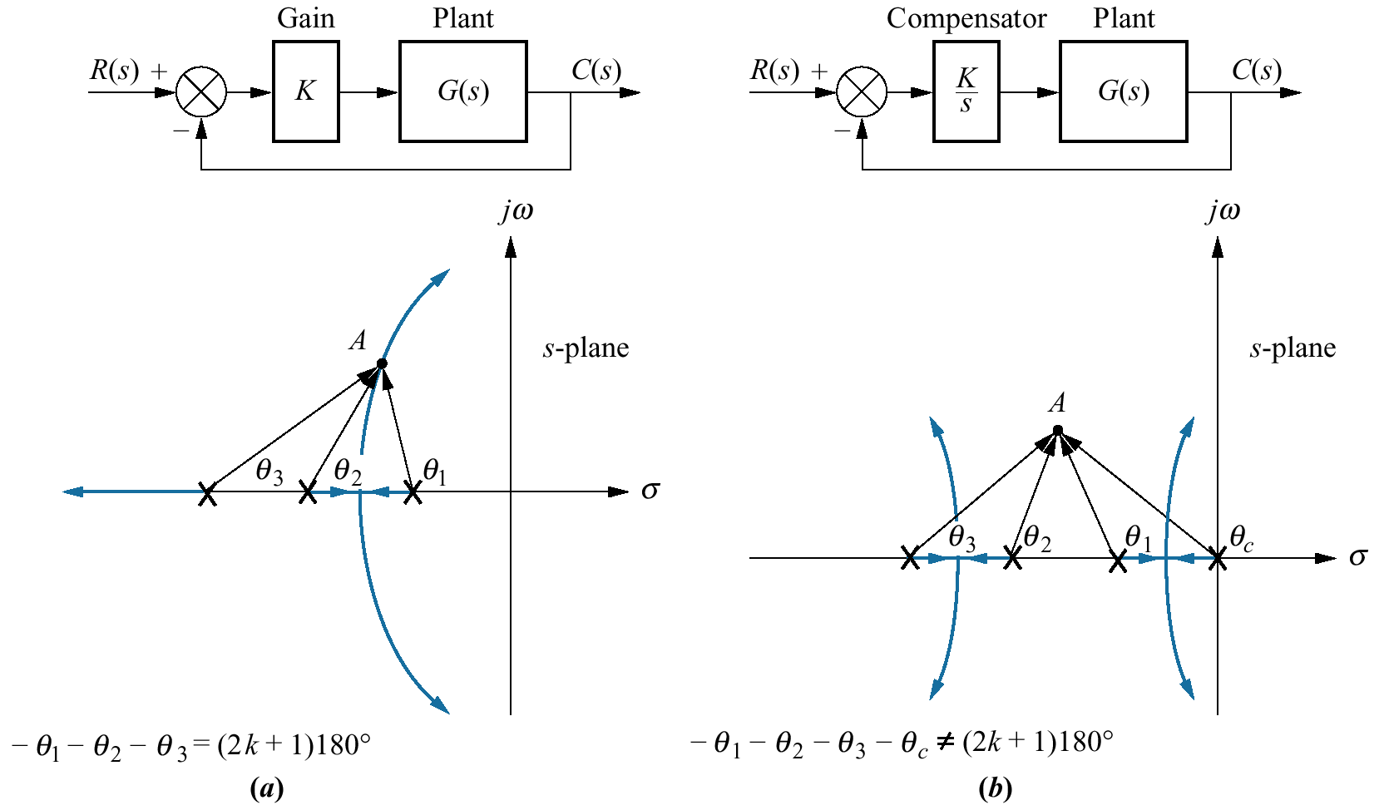
Figure 9.3
Pole at A is:
a. on the root locus
without compensator;
b. not on the
root locus with
compensator
pole added;
(figure continues)

Slide 5
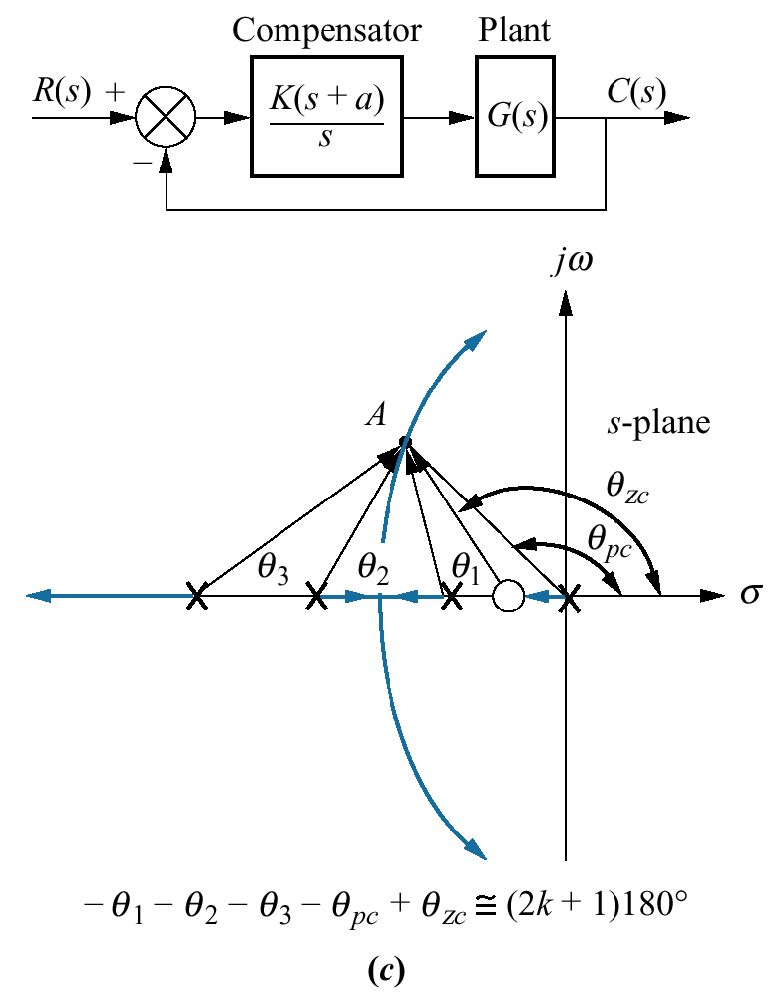
Figure 9.3
(continued )
c. approximately on
the root locus with
compensator pole
and zero added

Slide 6
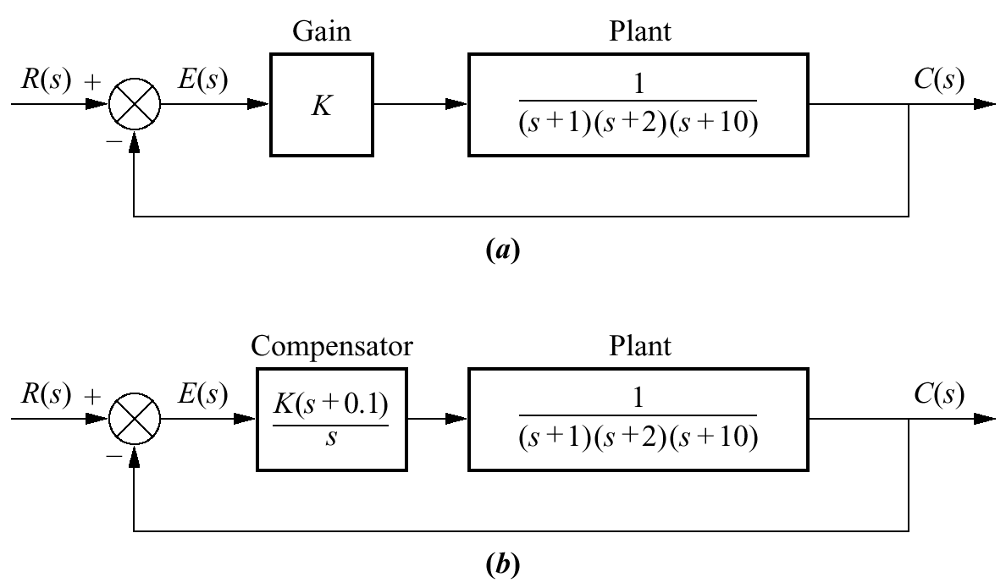
Figure 9.4
Closed-loop
system for
Example 9.1:
a. before
compensation;
b. after ideal integral
compensation

Slide 7
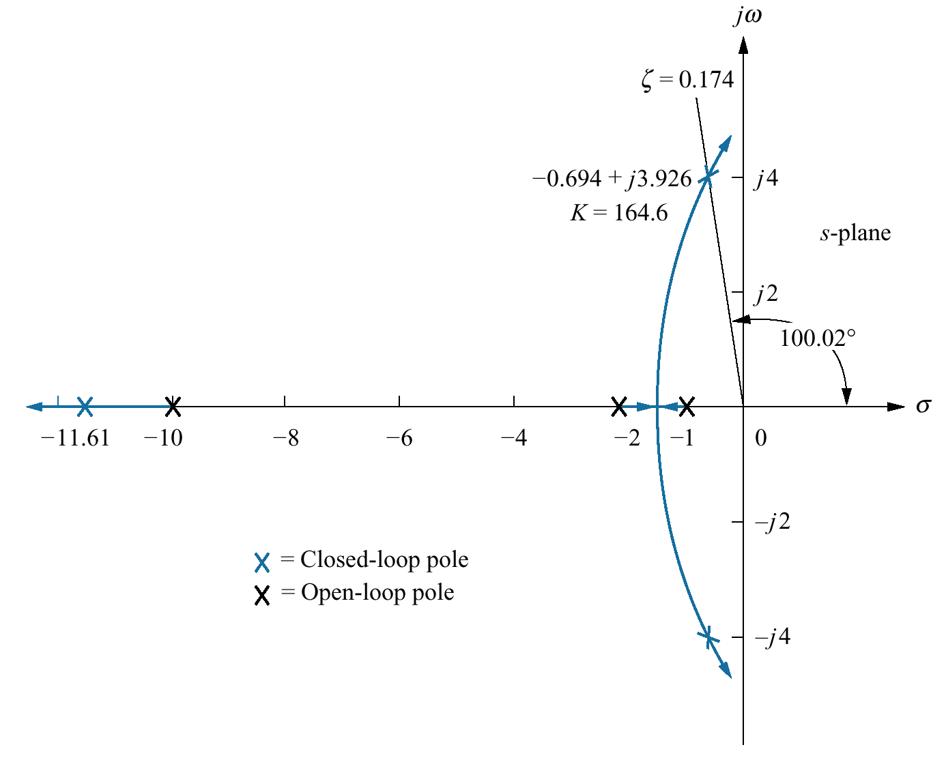
Figure 9.5
Root locus for
uncompensated
system of
Figure 9.4(a)

Slide 8
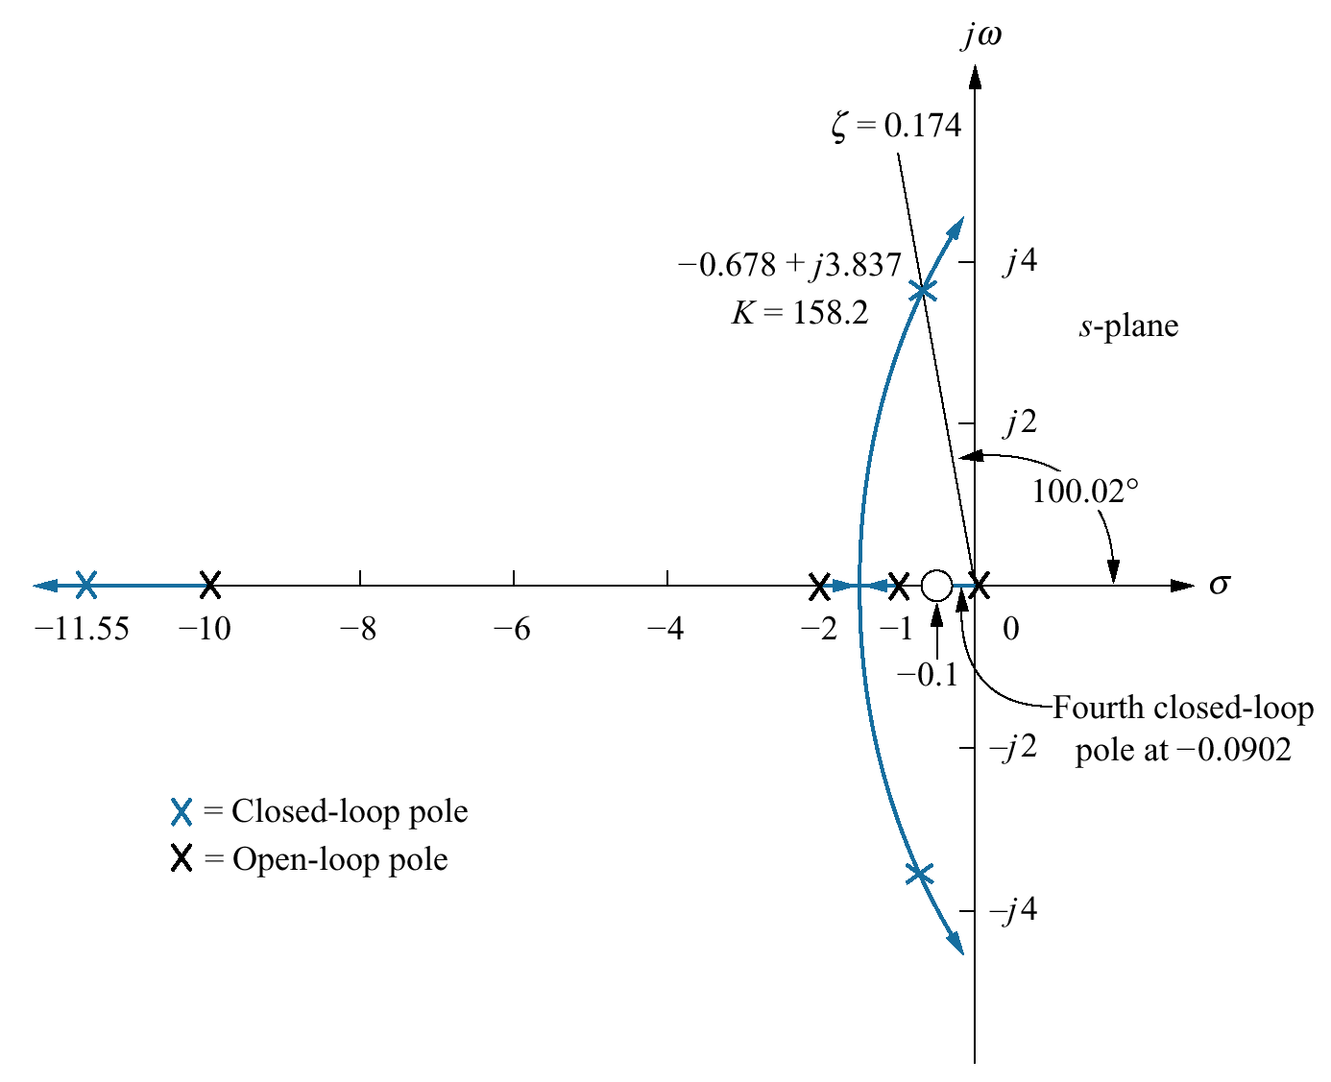
Figure 9.6
Root locus for
compensated
system
of Figure 9.4(b)

Slide 9
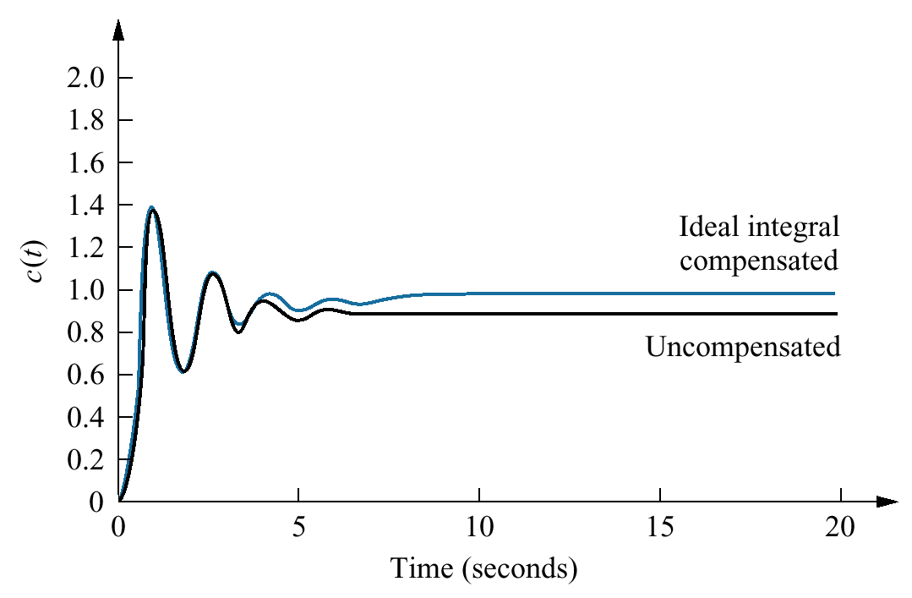
Figure 9.7
Ideal integral compensated
system response and the
uncompensated system
response of Example 9.1

Slide 10
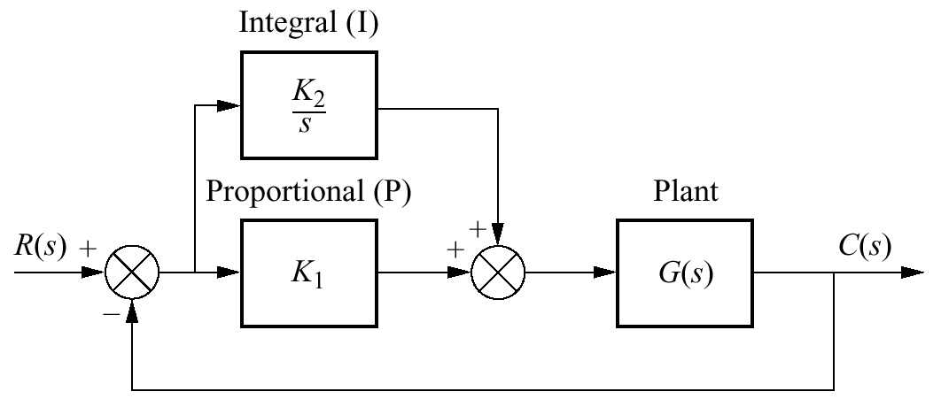
Figure 9.8
PI controller

Slide 11
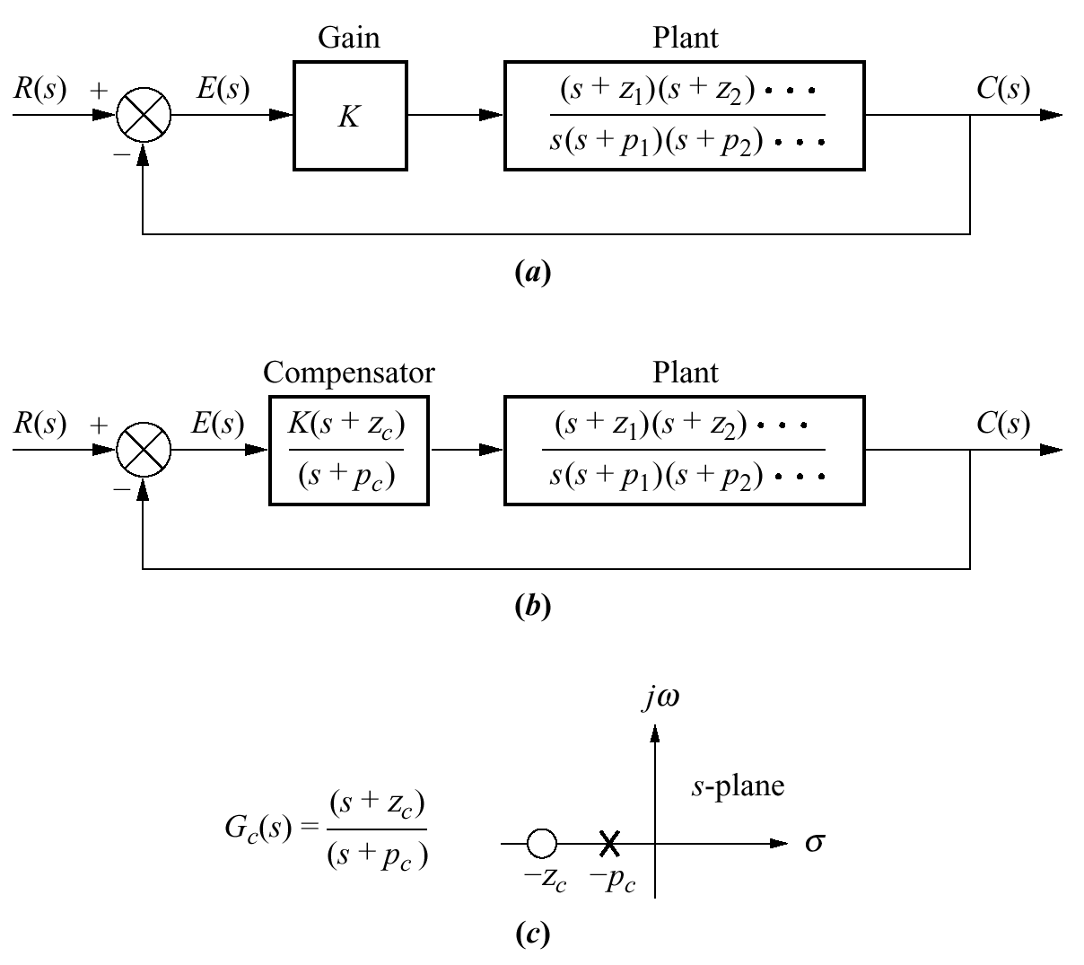
Figure 9.9
a. Type 1
uncompensated
system;
b. Type 1
compensated
system;
c. compensator
pole-zero plot

Slide 12
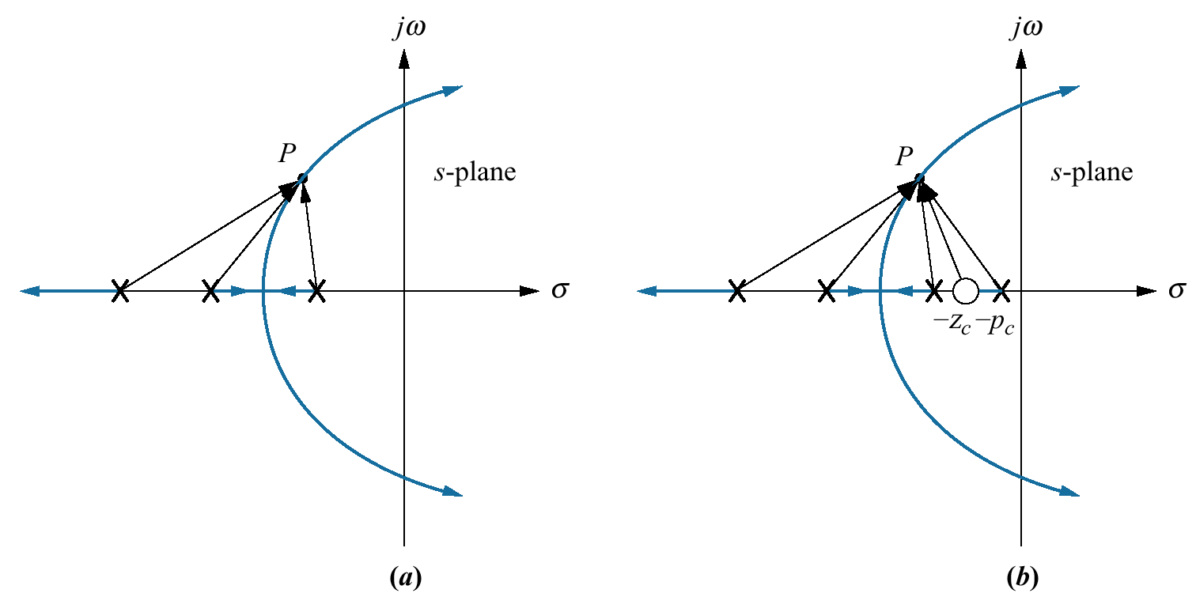
Figure 9.10
Root locus:
a. before lag compensation;
b. after lag compensation

Slide 13
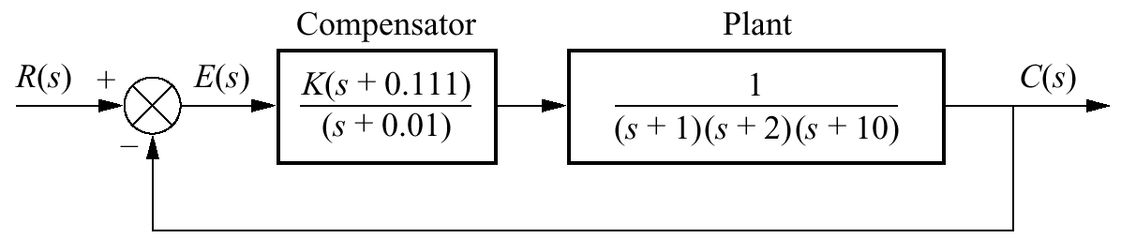
Figure 9.11
Compensated system
for Example 9.2

Slide 14
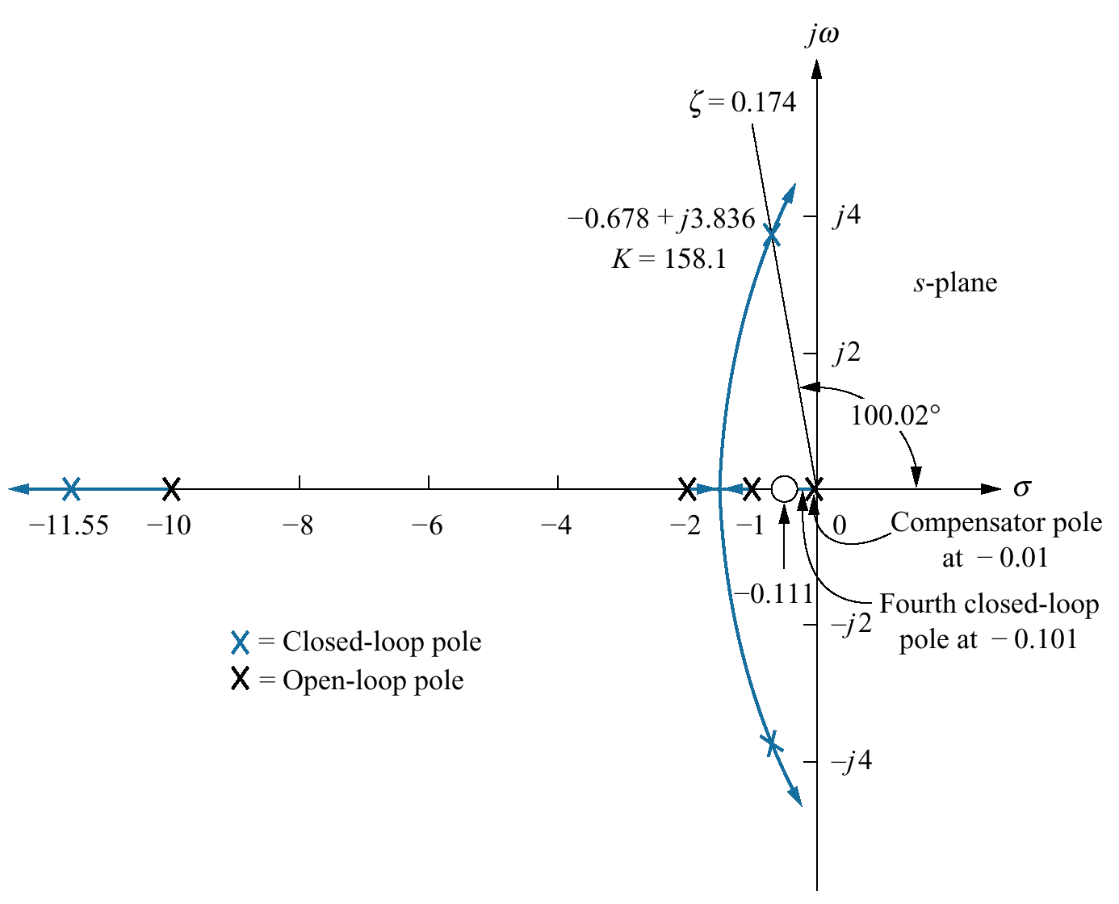
Figure 9.12
Root locus for
compensated system
of Figure 9.11

Slide 15
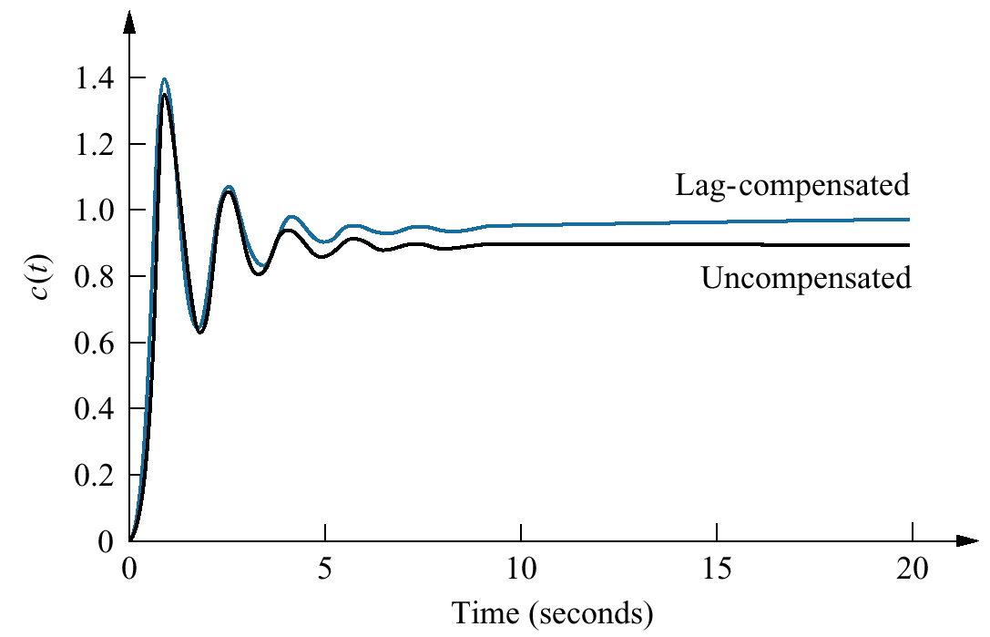
Figure 9.13
Step responses of
uncompensated and
lag-compensated
systems for
Example 9.2

Slide 16
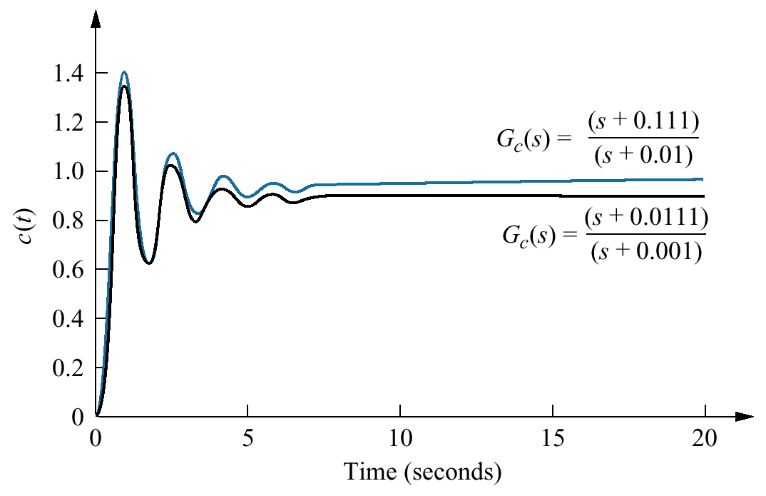
Figure 9.14
Step responses of the system for Example 9.2 using different lag compensators

Slide 17
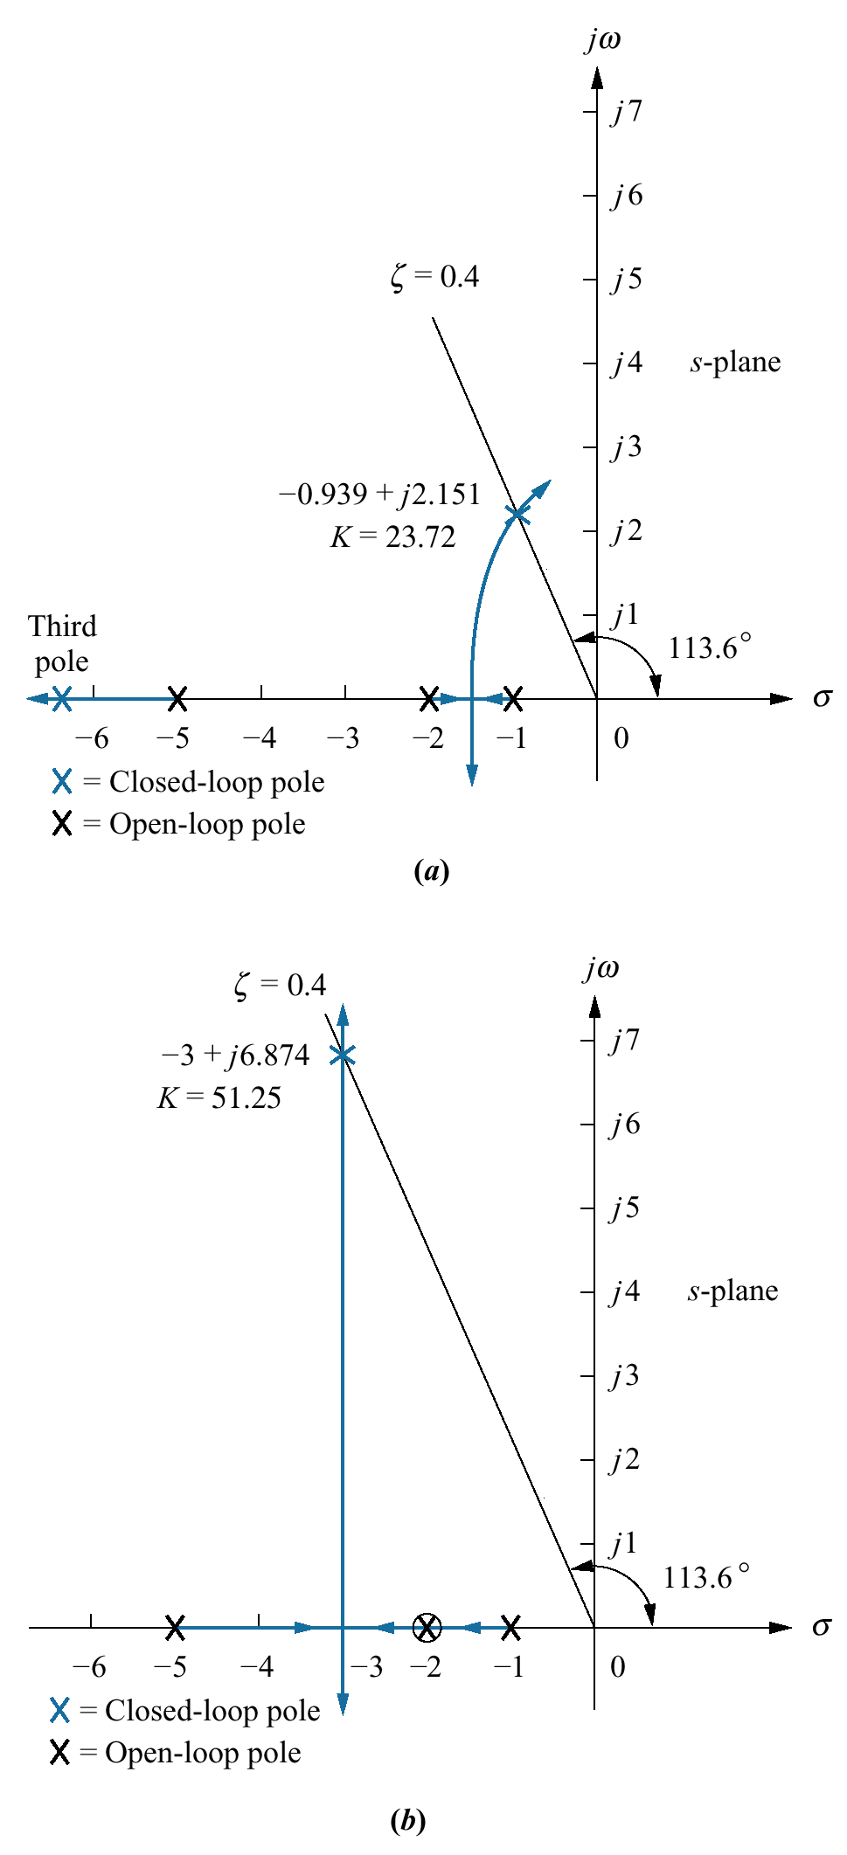
Figure 9.15
Using ideal derivative
compensation:
a. uncompensated;
b. compensator
zero at –2;
(figure continues)

Slide 18
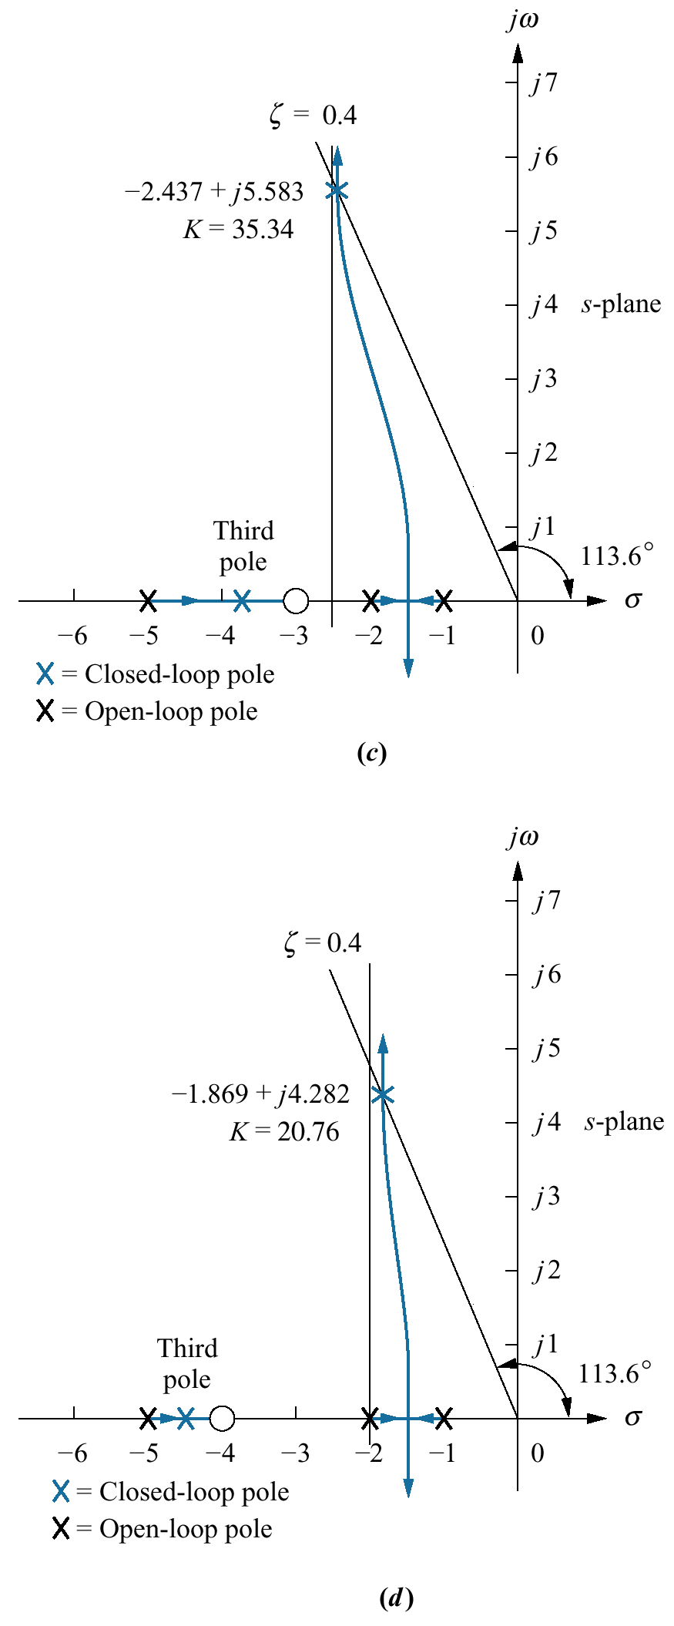
Figure 9.15
(continued)
c. compensator
zero at –3;
d. compensator
zero at – 4

Slide 19
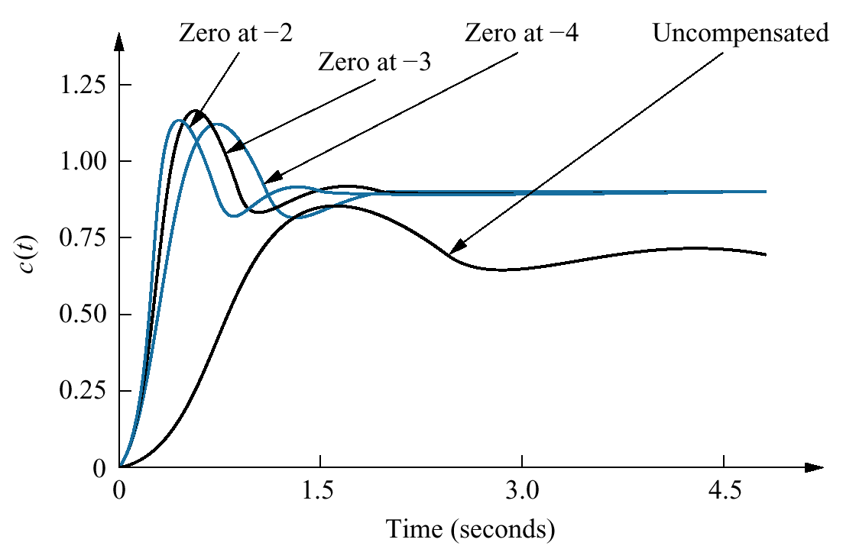
Figure 9.16
Uncompensated system
and ideal derivative
compensation solutions
from Table 9.2

Slide 20
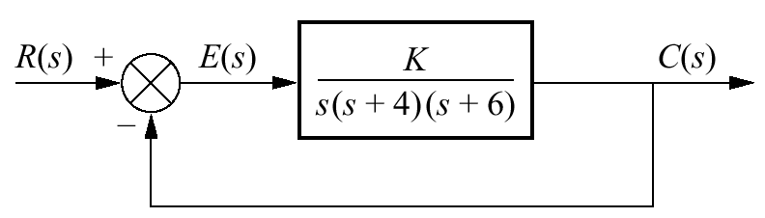
Figure 9.17
Feedback
control system
for Example 9.3

Slide 21
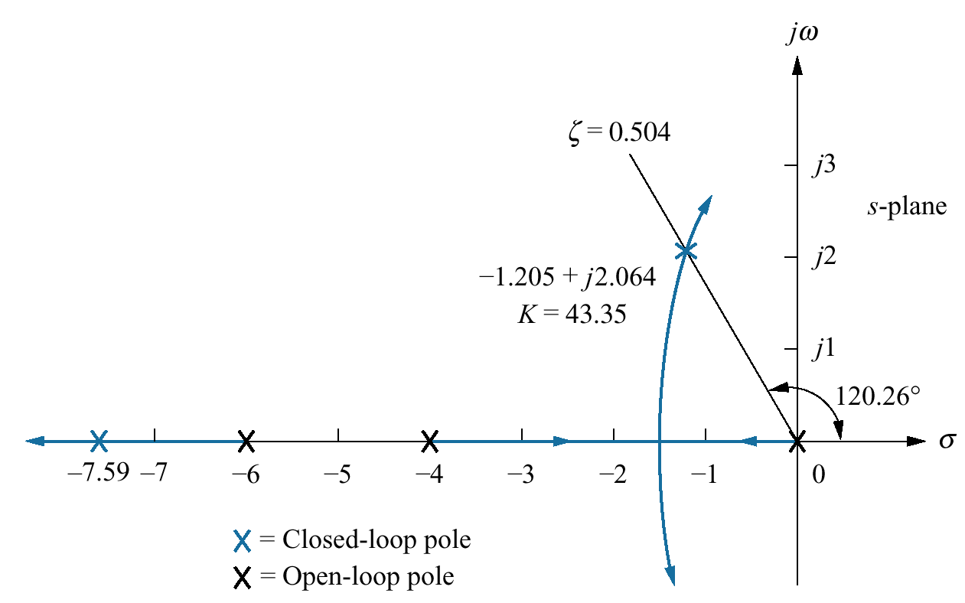
Figure 9.18 Root locus for
uncompensated
system shown in
Figure 9.17

Slide 22
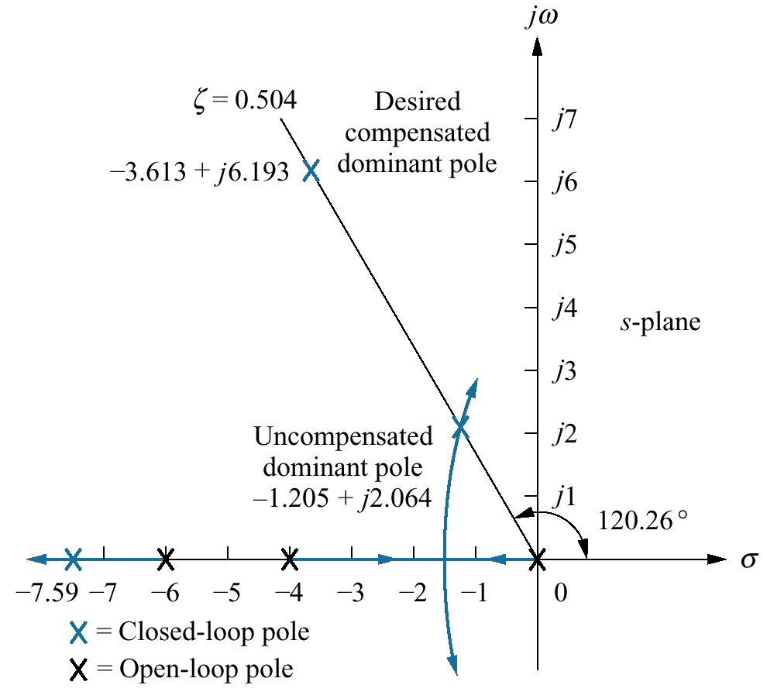
Figure 9.19
Compensated
dominant pole
superimposed over
the uncompensated
root locus for
Example 9.3

Slide 23
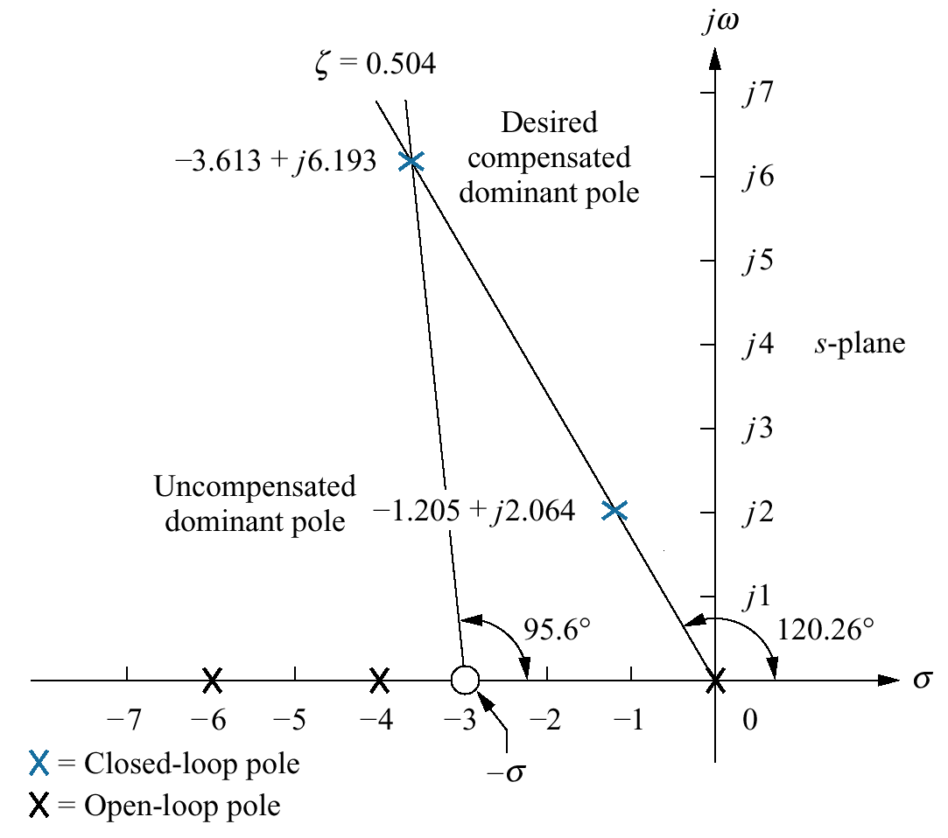
Figure 9.20
Evaluating the location
of the compensating
zero for Example 9.3

Slide 24
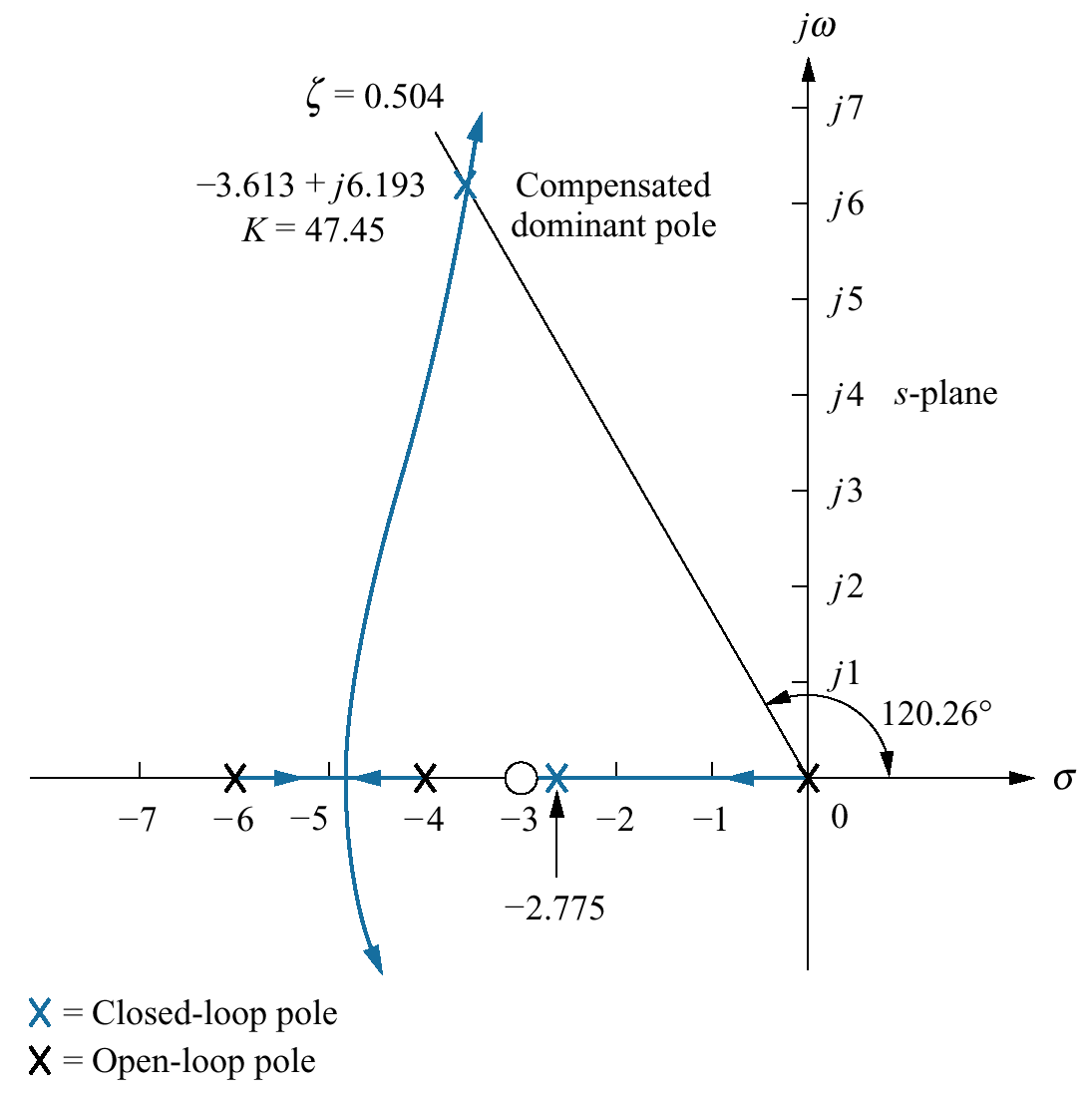
Figure 9.21
Root locus for the
compensated system
of Example 9.3

Slide 25
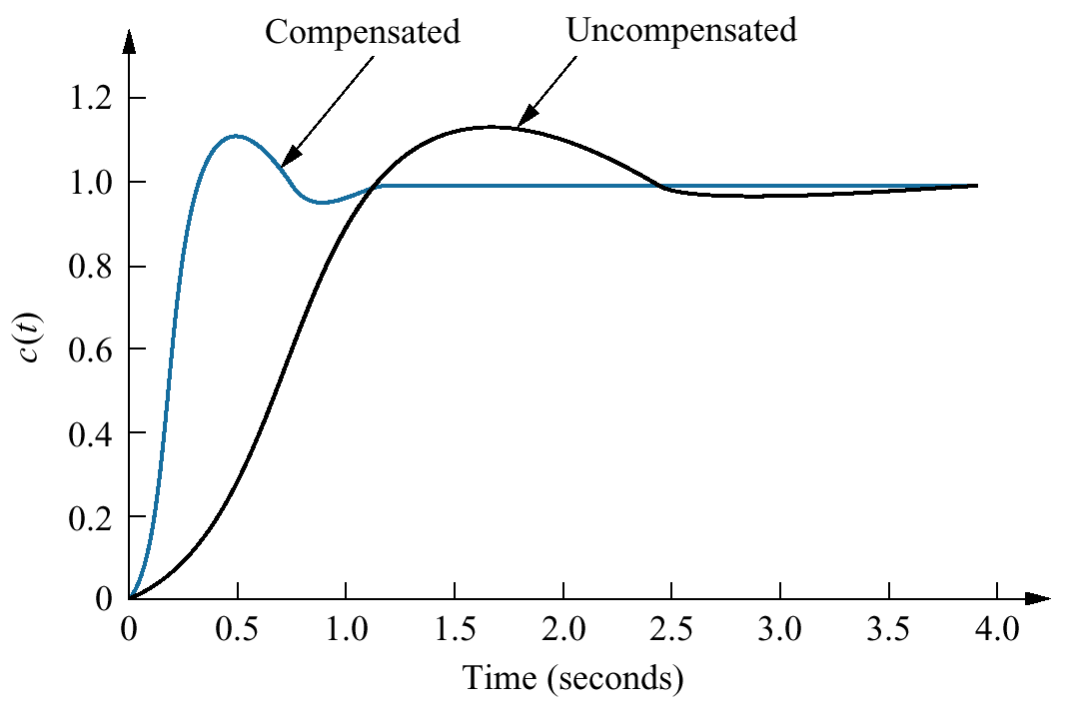
Figure 9.22
Uncompensated and
compensated system
step responses of
Example 9.3

Slide 26
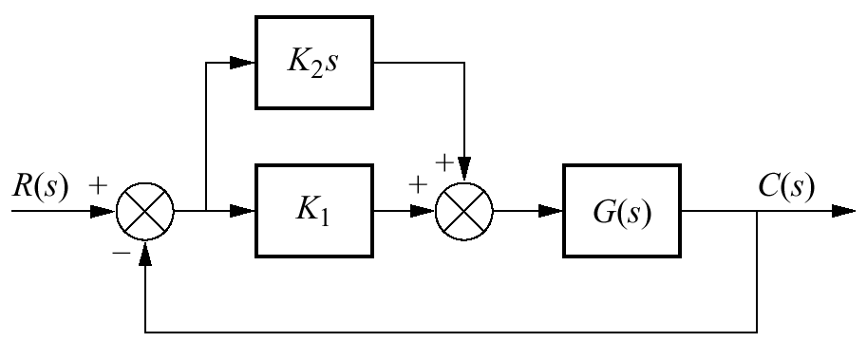
Figure 9.23
PD controller

Slide 27
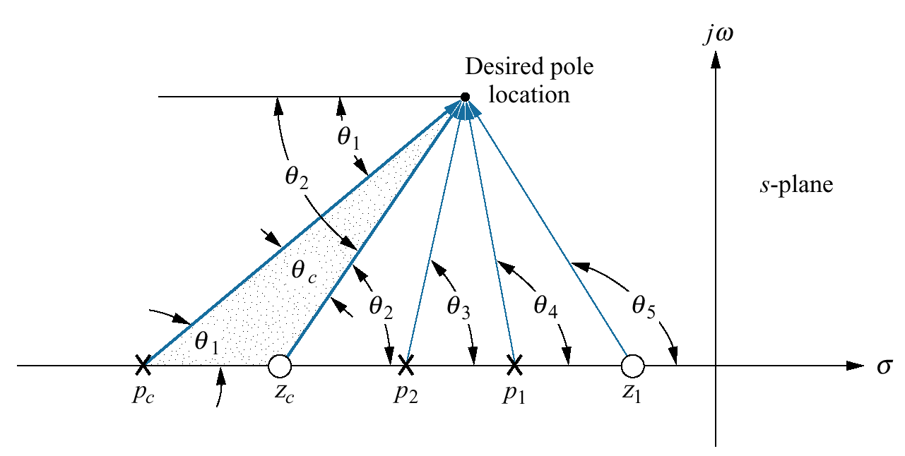
Figure 9.24
Geometry of lead
compensation

Slide 28
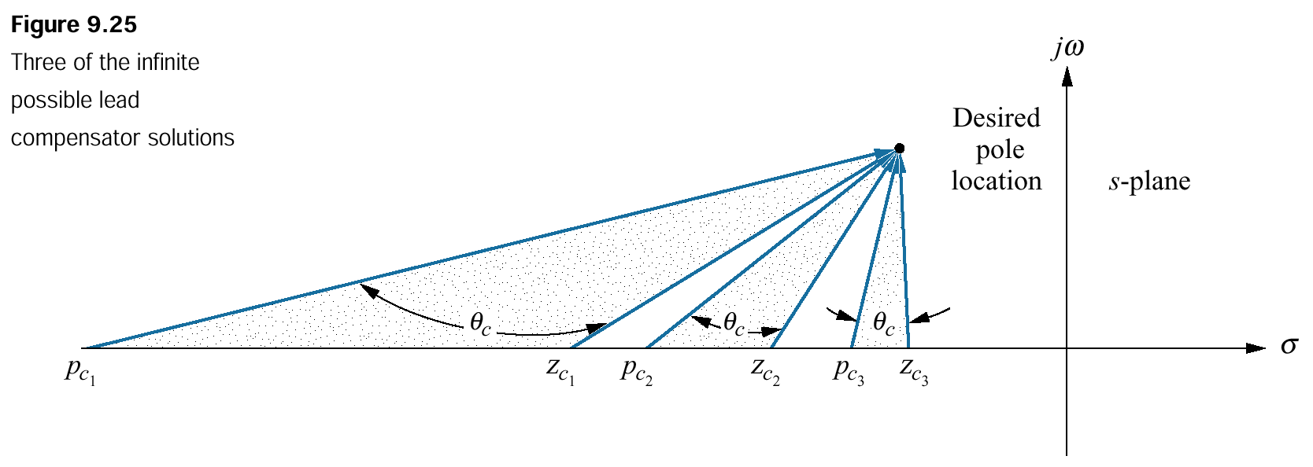
Figure 9.25
Three of the infinite
possible lead
compensator solutions

Slide 29
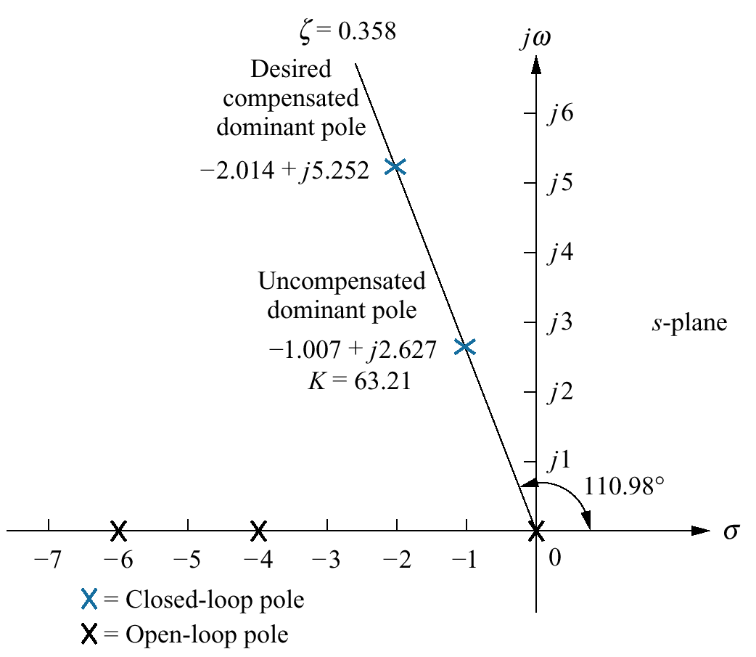
Figure 9.26
Lead compensator
design, showing
evaluation of
uncompensated
and compensated
dominant poles for
Example 9.4

Slide 30
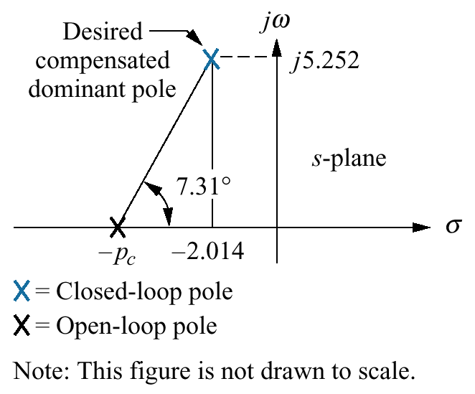
Figure 9.27
s -plane picture
used to calculate
the location of the
compensator pole for
Example 9.4

Slide 31
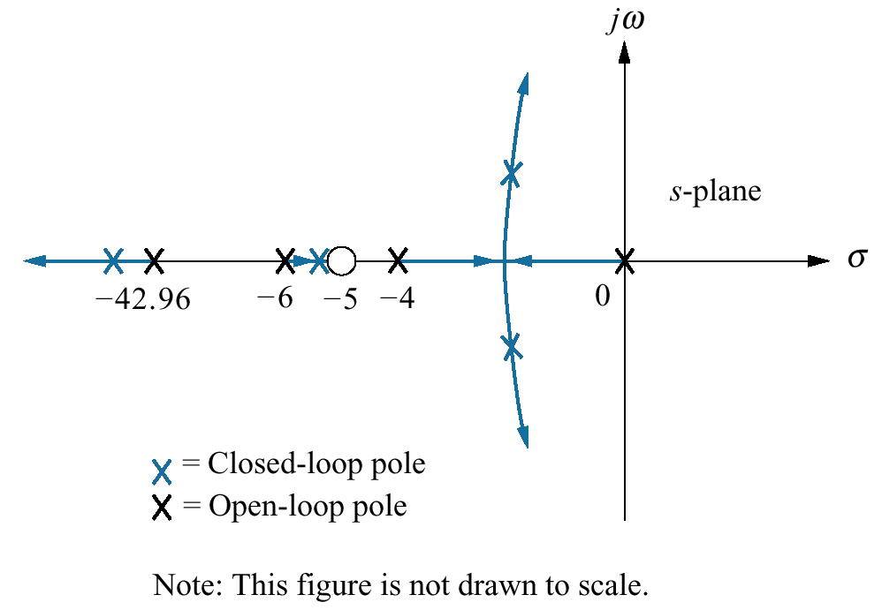
Figure 9.28
Compensated system
root locus

Slide 32
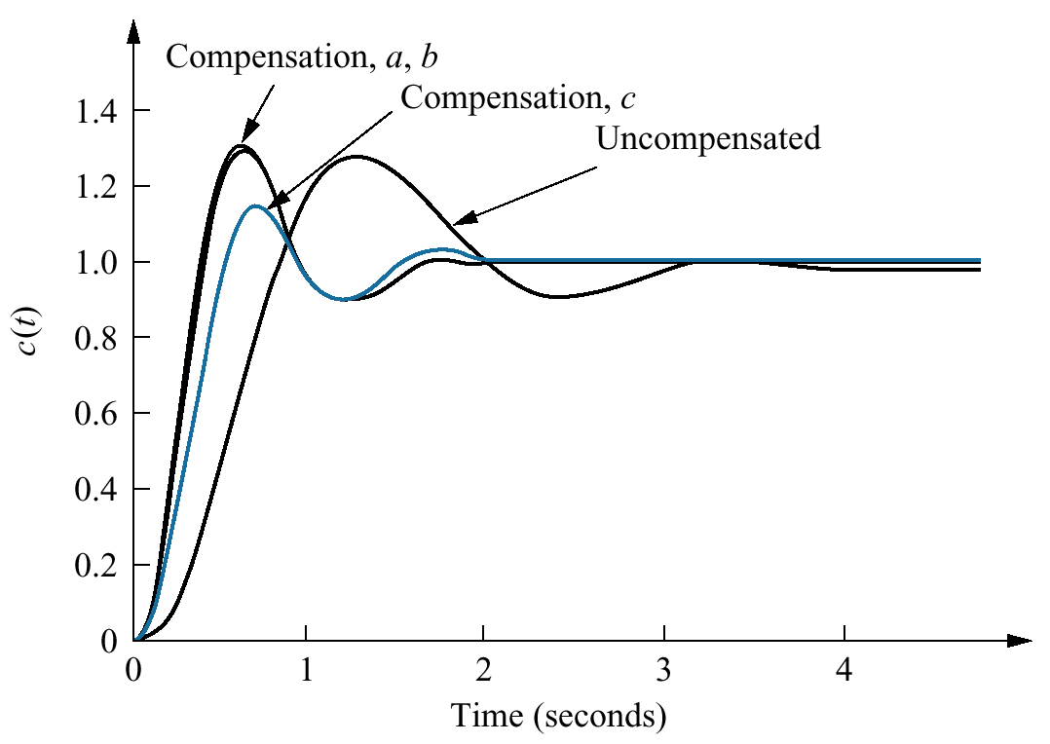
Figure 9.29
Uncompensated
system and lead
compensation
responses for
Example 9.4

Slide 33
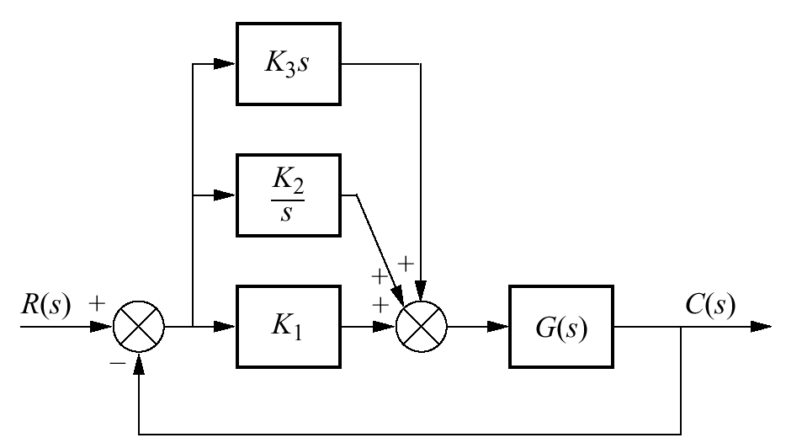
Figure 9.30
PID controller

Slide 34
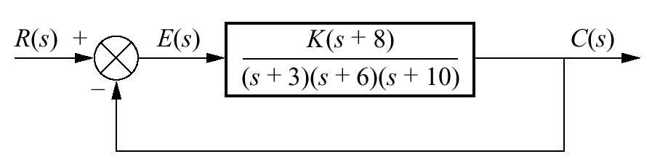
Figure 9.31
Uncompensated
feedback control
system for
Example 9.5

Slide 35
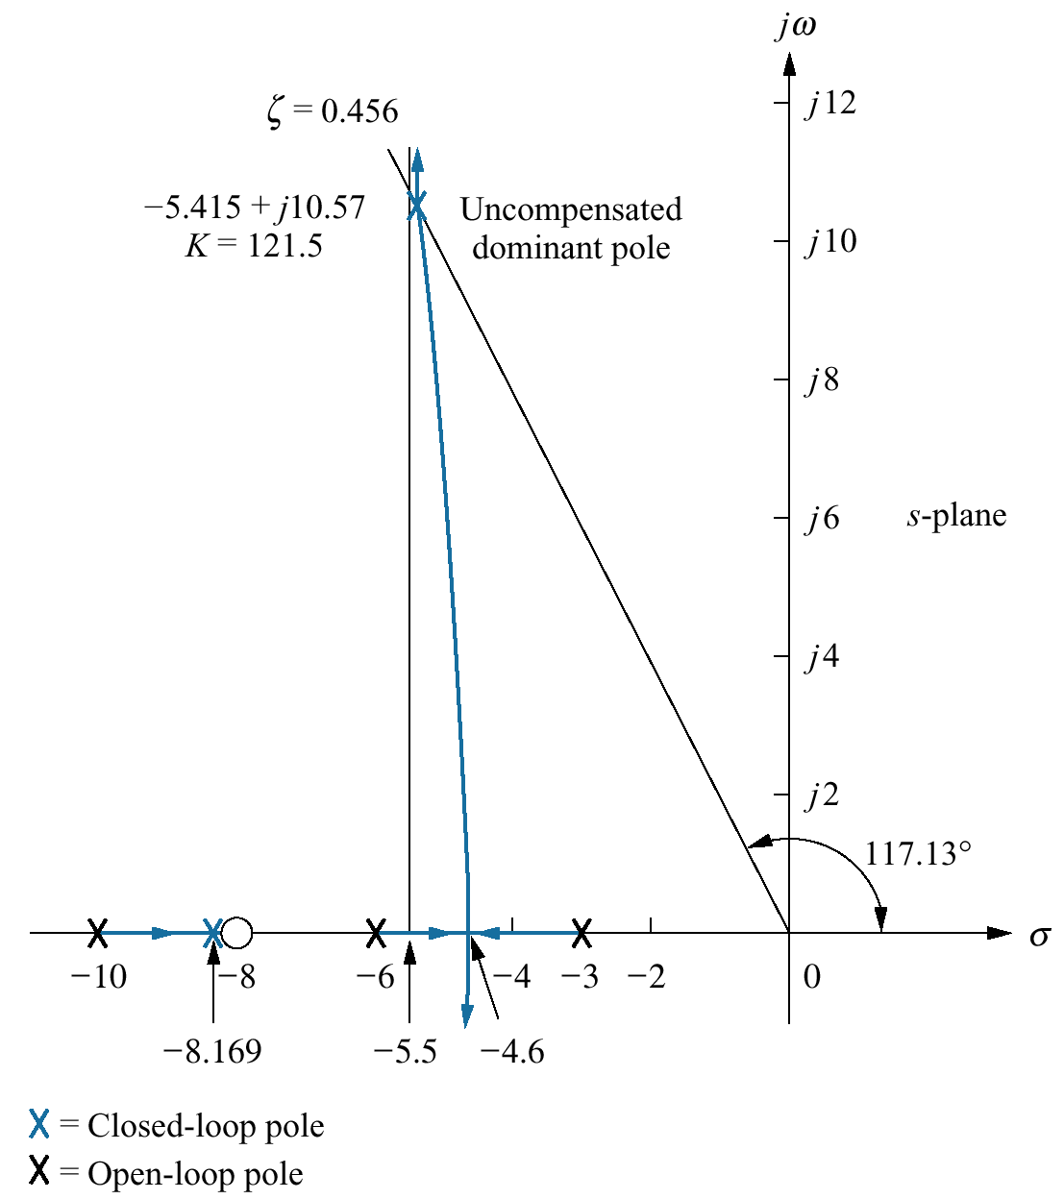
Figure 9.32
Root locus for the
uncompensated
system of
Example 9.5

Slide 36
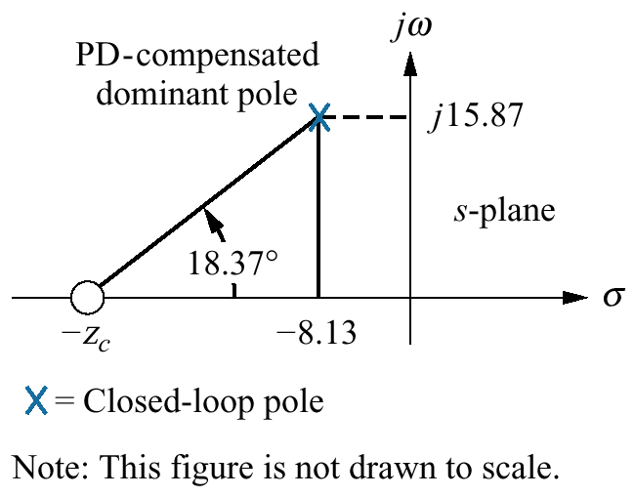
Figure 9.33
Calculating the PD
compensator zero
for Example 9.5

Slide 37
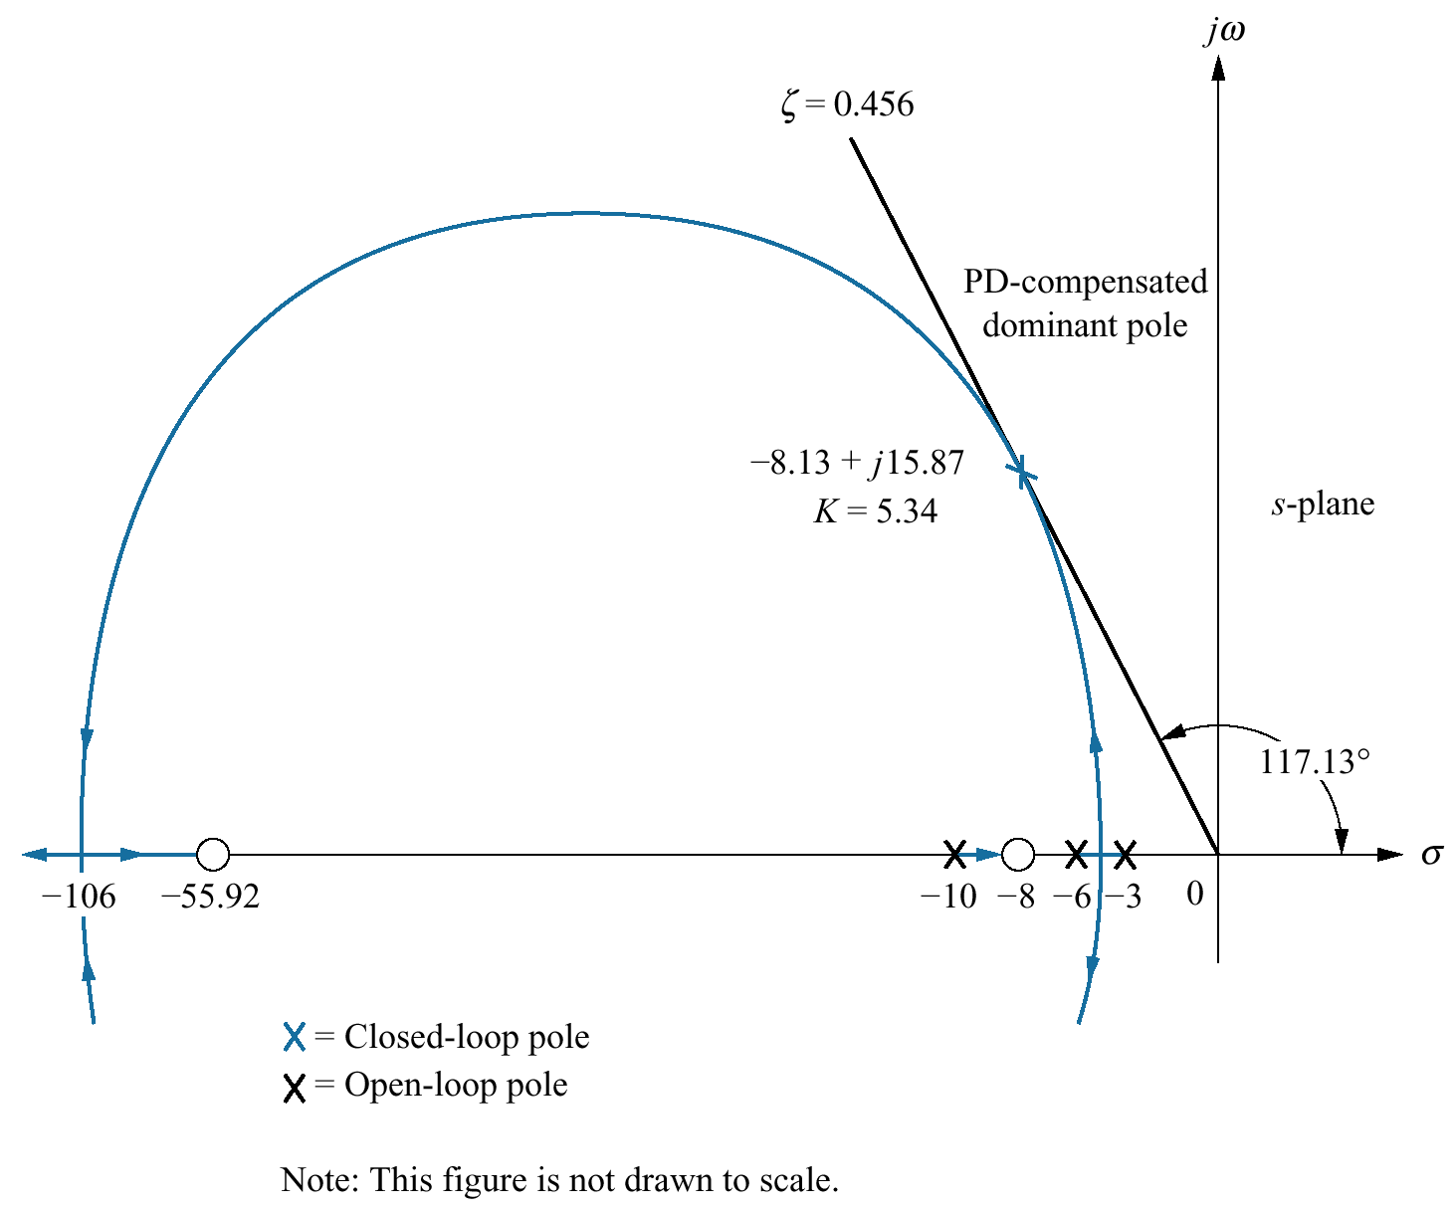
Figure 9.34
Root locus for
PD-compensated
system of
Example 9.5

Slide 38
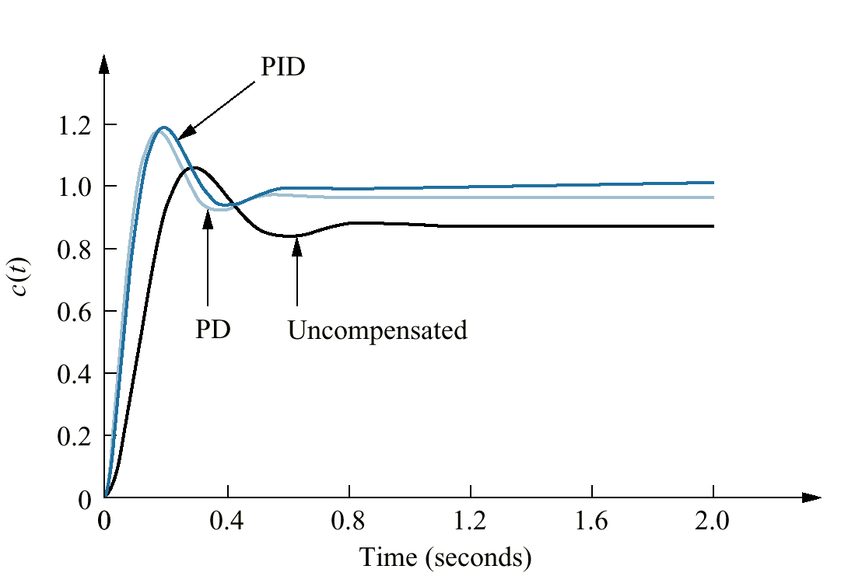
Figure 9.35
Step responses for
uncompensated, PD-
compensated, and
PID- compensated
systems of
Example 9.5

Slide 39
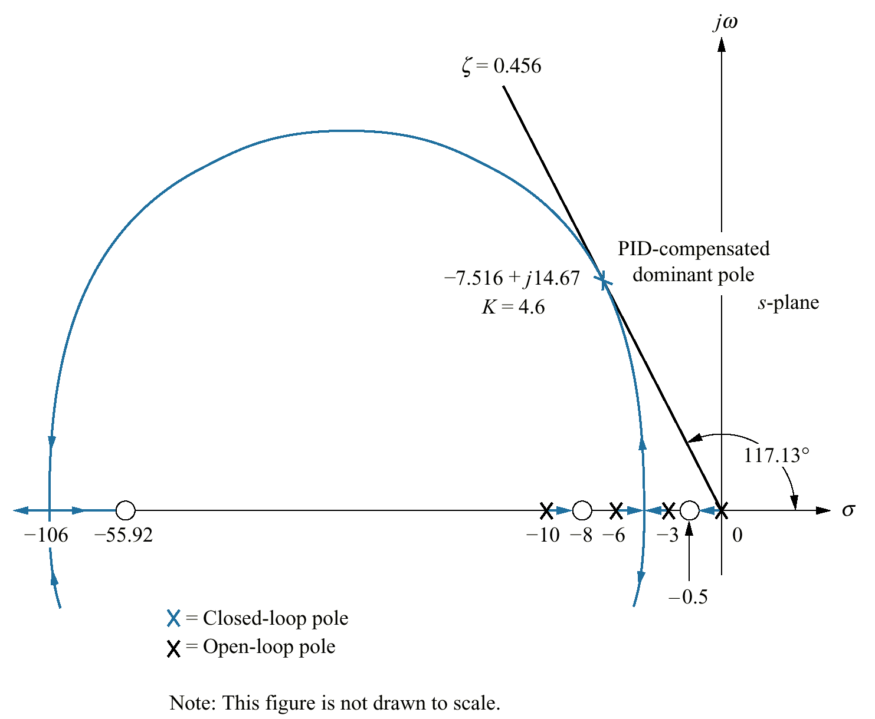
Figure 9.36
Root locus for PID-
compensated
system
of Example 9.5

Slide 40
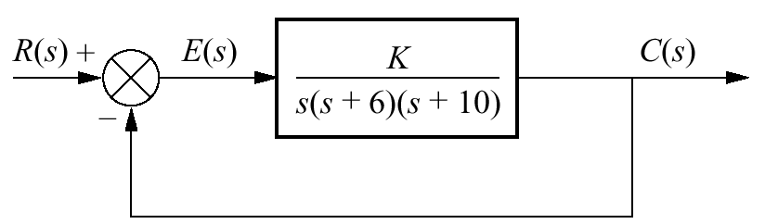
Figure 9.37
Uncompensated
system for
Example 9.6

Slide 41
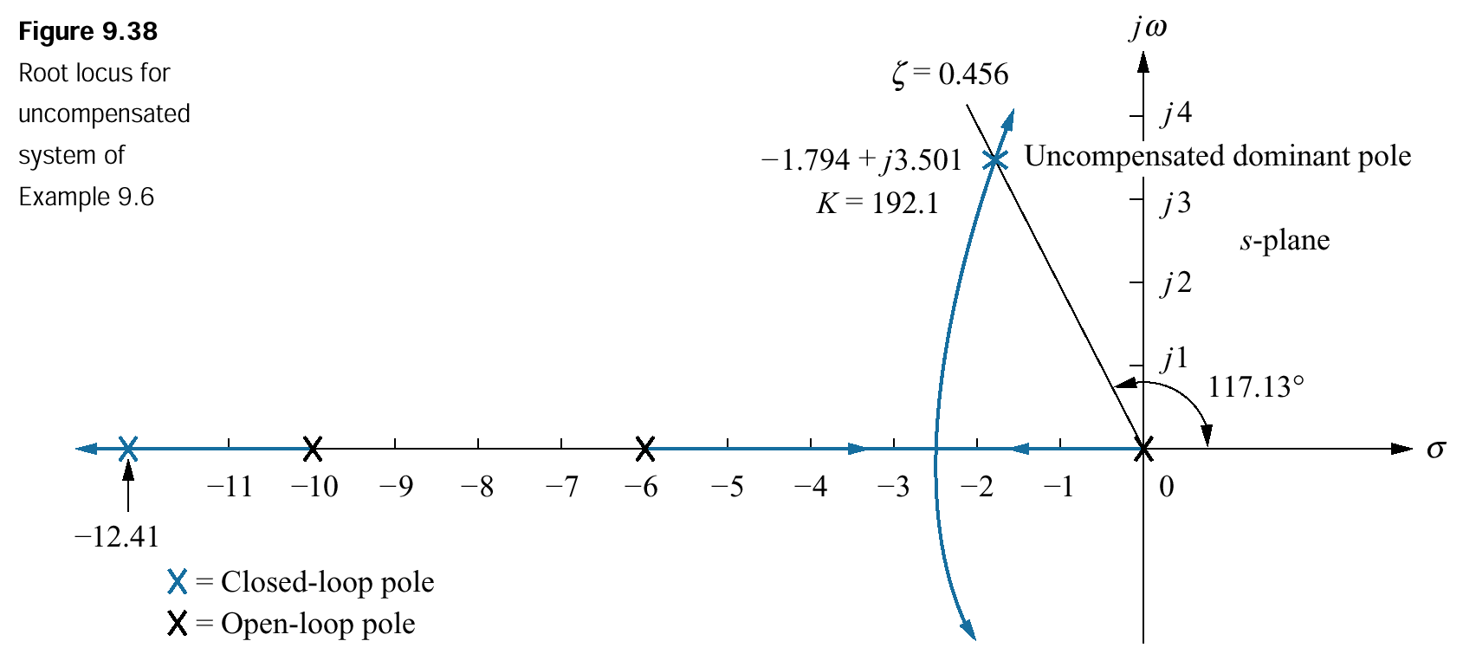
Figure 9.38
Root locus for
uncompensated
system of
Example 9.6

Slide 42
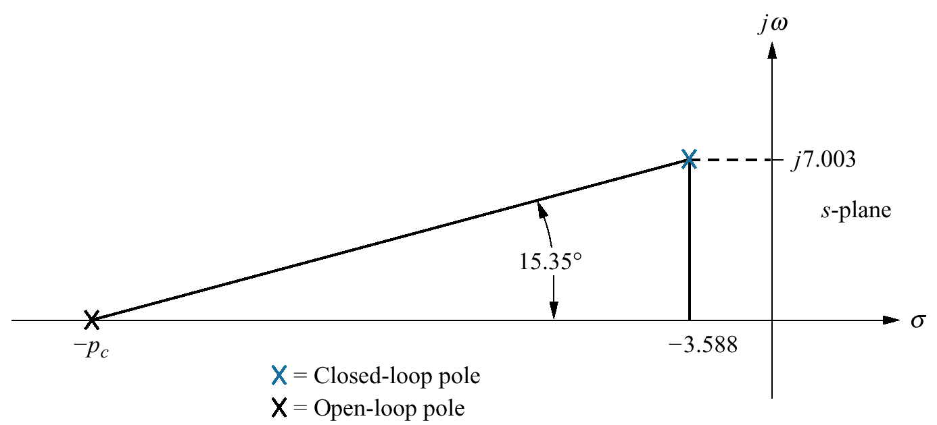
Figure 9.39
Evaluating the
compensator pole for
Example 9.6

Slide 43
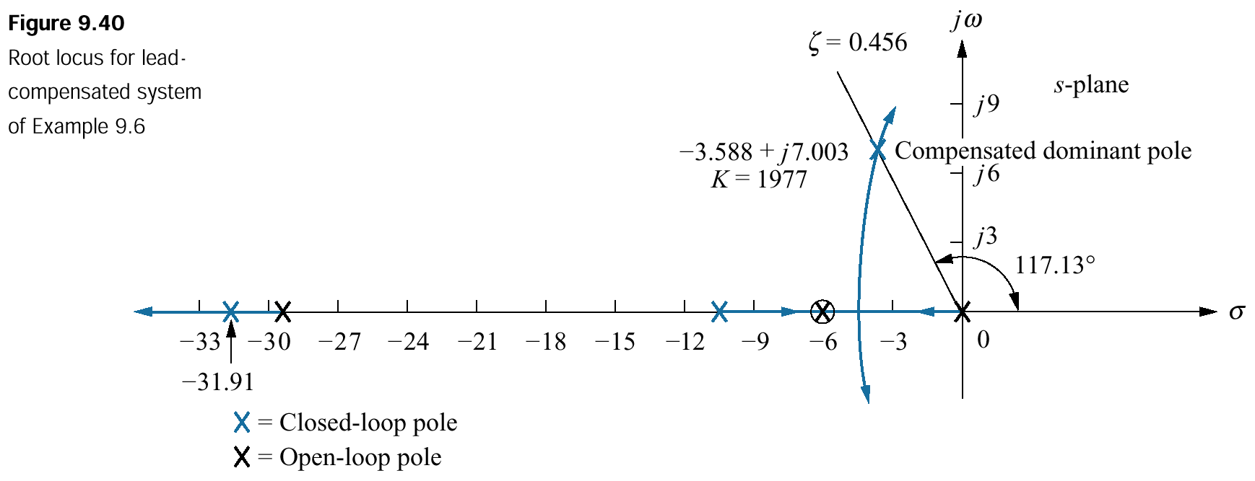
Figure 9.40
Root locus for lead-compensated system of Example 9.6

Slide 44
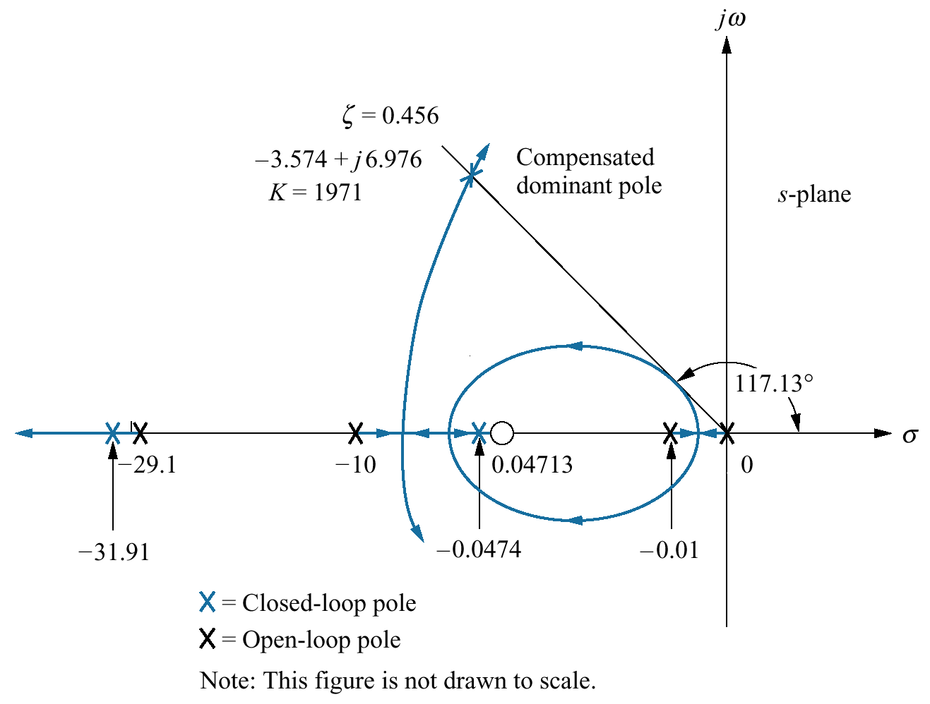
Figure 9.41
Root locus for lag-lead-
compensated system
of Example 9.6

Slide 45
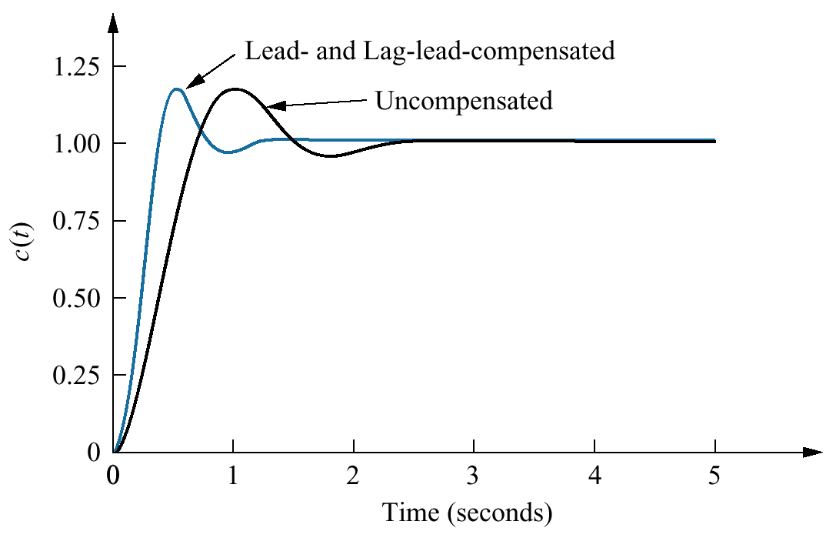
Figure 9.42
Improvement in step
response for
lag- lead- compensated
system of
Example 9.6

Slide 46
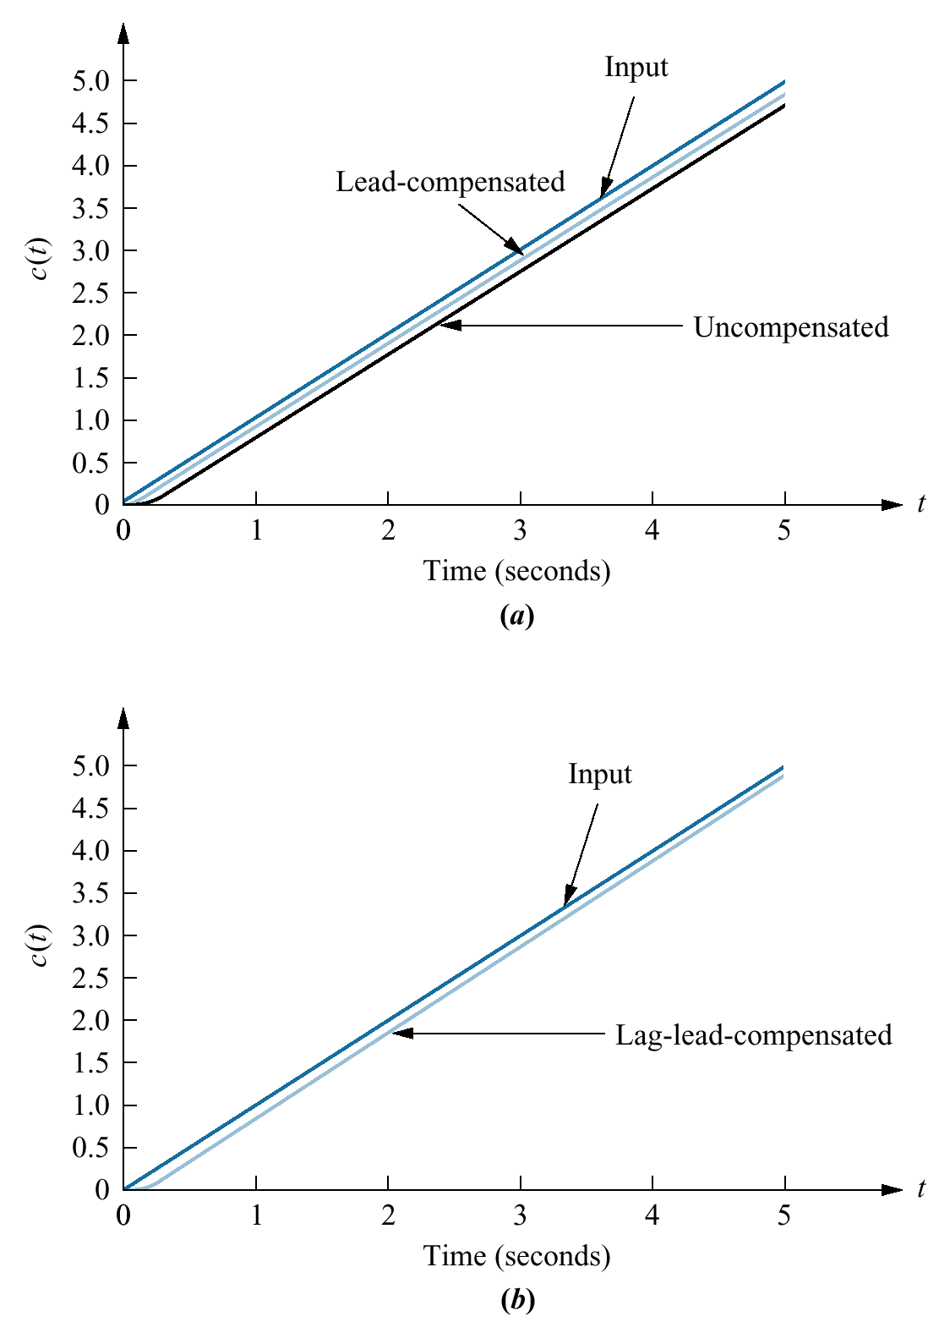
Figure 9.43
Improvement in
ramp response error
for the system of
Example 9.6:
a. lead-compensated;
b. lag-lead-
compensated

Slide 47
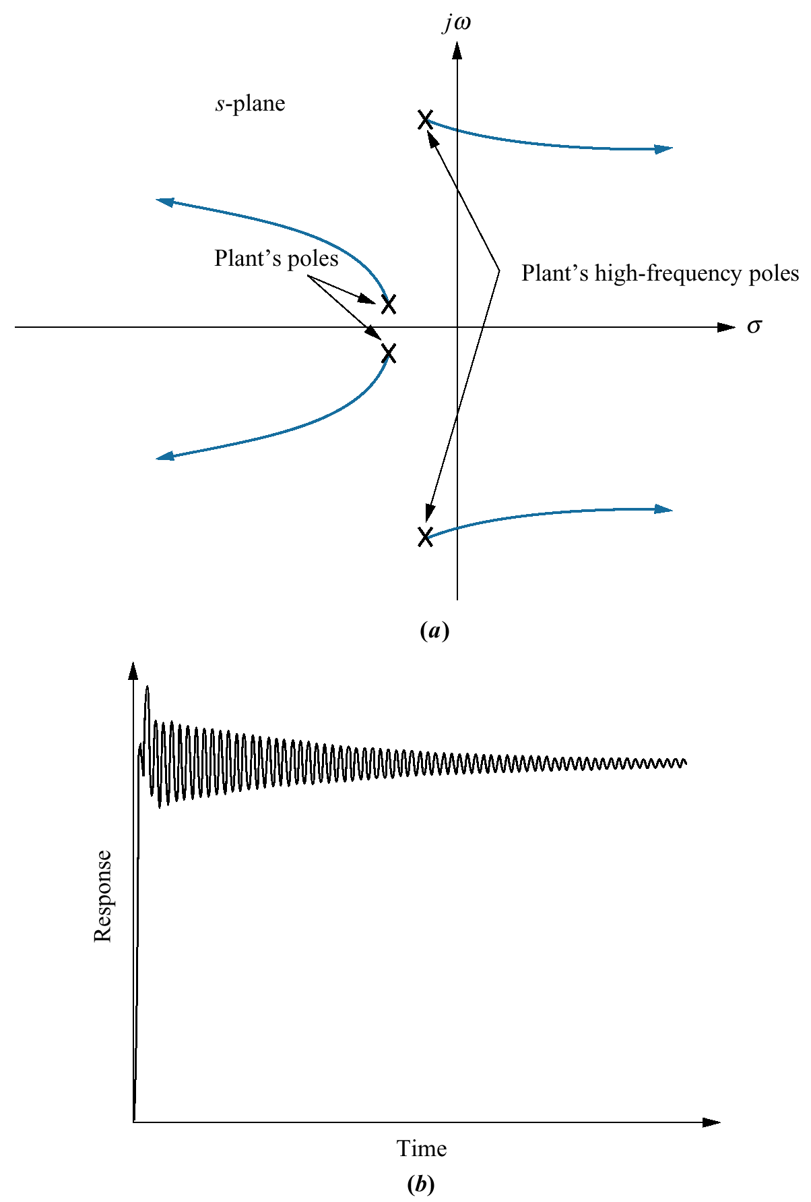
Figure 9.44
a. Root locus before
cascading notch filter;
b. typical closed-loop
step response before
cascading notch filter;
(figure continues)

Slide 48
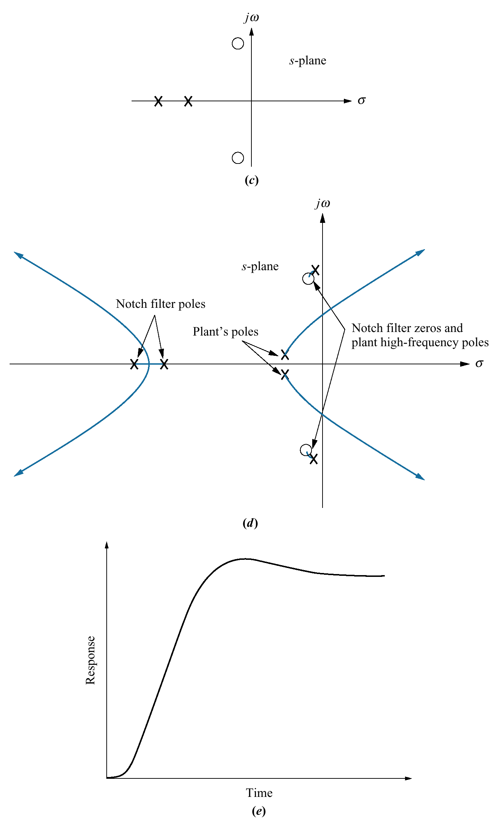
Figure 9.44
(continued)
c. pole-zero plot
of a notch filter;
d. root locus after
cascading notch filter;
e. closed-loop step
response after
cascading notch filter.

Slide 49
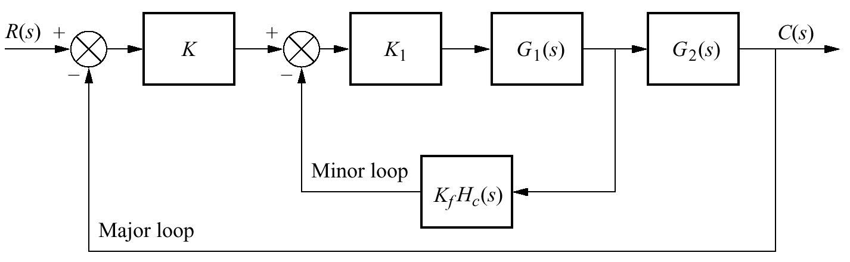
Figure 9.45
Generic control
system with feedback
compensation

Slide 50
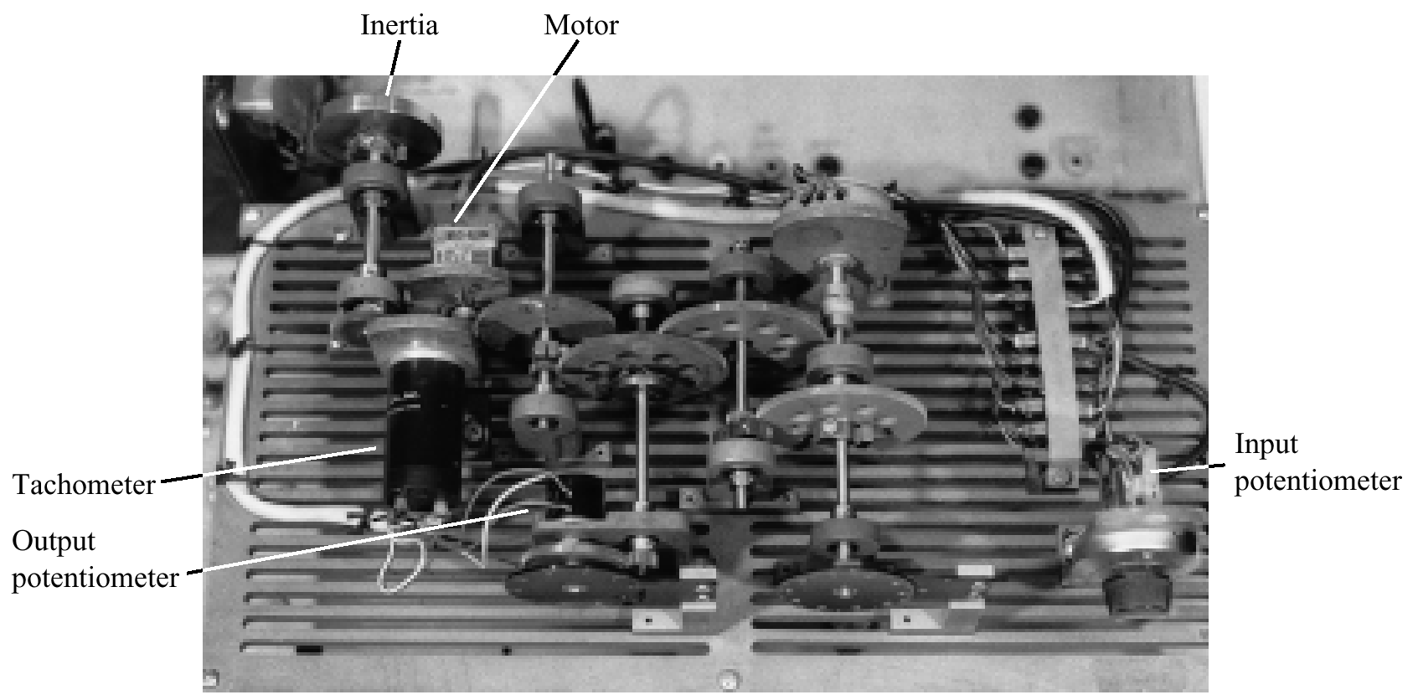
Figure 9.46
A position control system that uses a tachometer as a differentiator in the feedback path. Can you see the similarity between this system and the schematic on
the front end papers?

Slide 51
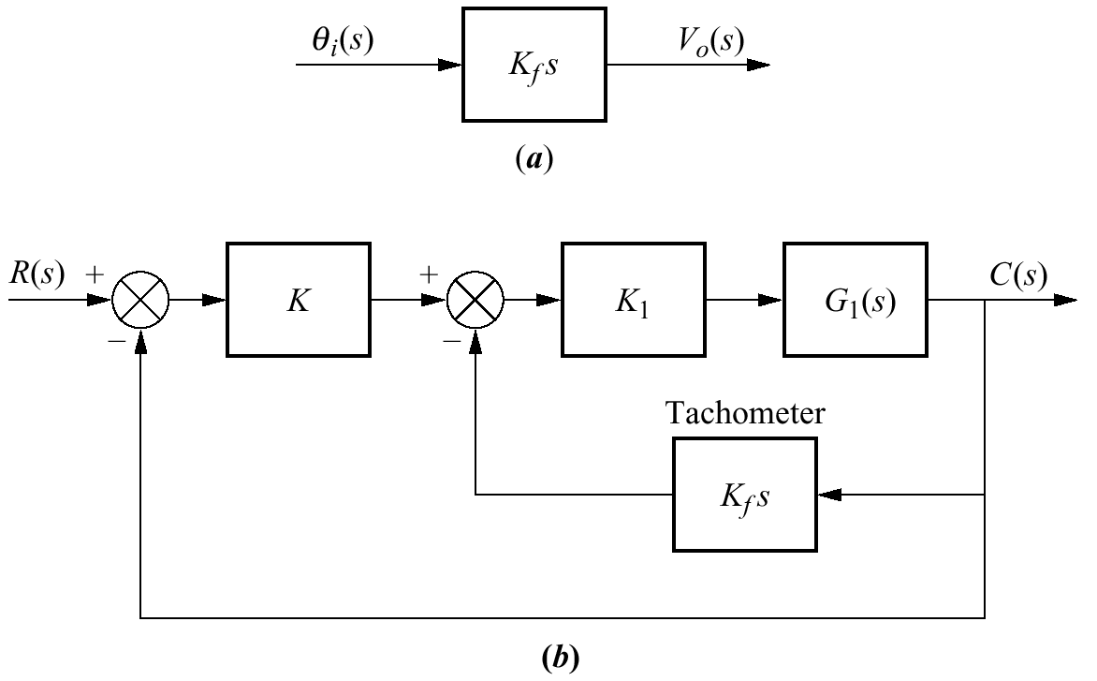
Figure 9.47
a. Transfer function of a tachometer;
b. tachometer feedback compensation

Slide 52

Figure 9.48
Equivalent
block diagram
of Figure 9.45

Slide 53


Figure 9.49
a. System for
Example 9.7;
b. system with
rate feedback
compensation;
c. equivalent
compensated
system;
d. equivalent
compensated
system, showing
unity feedback

Slide 54

Figure 9.50
Root locus for
uncompensated
system of
Example 9.7

Slide 55

Figure 9.51
Step response for
uncompensated
system of
Example 9.7

Slide 56

Figure 9.52
Finding the
compensator zero in Example 9.7

Slide 57

Figure 9.53
Root locus for the
compensated system
of Example 9.7

Slide 58

Figure 9.54
Step response for the
compensated system
of Example 9.7

Slide 59

Figure 9.55
a. Uncompensated
system and
b. feedback-
compensated system
for Example 9.8

Slide 60

Figure 9.56
Root locus for minor
loop of Example 9.8

Slide 61

Figure 9.57
Root locus for
closed-loop
system of
Example 9.8

Slide 62

Figure 9.58
Step response
simulation for
Example 9.8

Slide 63

Figure 9.59
System for
Skill-Assessment
Exercise 9.4

Slide 64

Figure 9.60
Operational amplifier
configured for transfer
function realization

Slide 65

Figure 9.61
Lag-lead compensator
implemented with
operational amplifiers

Slide 66

Figure 9.62
PID controller

Slide 67

Figure 9.63
Lag-lead compensator
implemented with
cascaded lag and lead
networks with isolation

Slide 68

Figure 9.64
Locating compensator
pole

Slide 69

Figure 9.65
Realization of
lag-lead
compensator

Slide 70

Figure 9.66
Step response of
lag-lead-
compensated
antenna control

Slide 71

Figure 9.67
Locating compensator
pole

Slide 72

Figure 9.68
Root locus for
lead-compensated
system

Slide 73

Figure 9.69
Step response of lead-
compensated UFSS
vehicle

Slide 74

Figure P9.1

Slide 75

Figure P9.2

Slide 76

Figure P9.3

Slide 77

Figure P9.4

Slide 78

Figure P9.5

Slide 79

Figure P9.6

Slide 80

Figure P9.7

Slide 81

Figure P9.8

Slide 82

Figure P9.9

Slide 83

Figure P9.10
Chemical process
temperature control
system

Slide 84

Figure P9.11
a. Magnetic levitation
system (©1993 IEEE);
b. block diagram

Slide 85

Figure P9.12
Simplified block
diagram for angle of
attack control

Slide 86

Figure P9.13
Simplified block
diagram of a self-
guiding vehicle’s
bearing angle control

